Slide 2

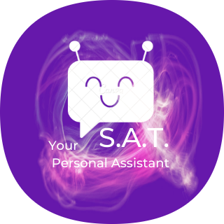
Mejor Project
Submitted in Partial fulfilment of
The Requirement for the Degree of
Bachelor of Computer Science
S.A.T – Personal Digital Assistant
Submitted by
Rishav Banerjee
Under the supervision and guidance of
Mr. Unmesh Mandal
Mr. Goutam Das
Mr. Apurba Jyoti Roy
Ms. Rimpi Saha
Department of Computer Science
Rishra Bidhan Chandra College
Calcutta University

Slide 3
Table of Contents:-
1.Introduction
2.Background / Review Related Work
1.1 Objectives of SAT : Domain Description
1.2 Nomenclature : Motivation and
1.3 Scope of the Work
2.1 User Manual
2.2 Voice Command Dictionary
3.Methodology
4.Implementation
3.1 Code Structure
3.2 Service Permissions
3.3 Dependencies and APIs
5. Result and Discussions
5.1 Future Scopes
5.2 Constraints
6. Bibliography

Slide 4
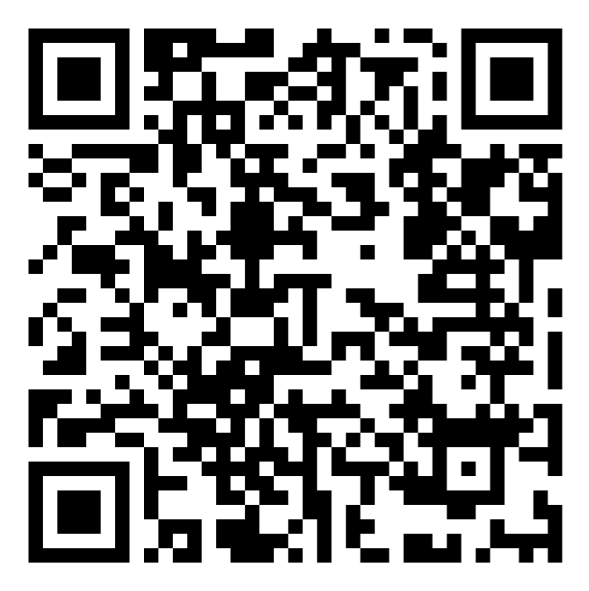

Objectives of S.A.T :
Domain Description
1.Unlike other virtual assistants, Sat will use On Device Intelligence and resources to process commands and data. That way user’s privacy and Confidentiality can be maintained.
(Only works on Snapdragon 8 Gen 1 Processors)
Scan the QR to Download the APK also get access to User Manual and Voice Command Dictionary
2. It will be completely open source project so anyone can contribute and can use it for their organization for personal purposes also.
3. This can be integrated with any Operating system such as iOS and Linux based Distros with the help of React Native or using Ionic framework.
(right now only developed for android )

Slide 5
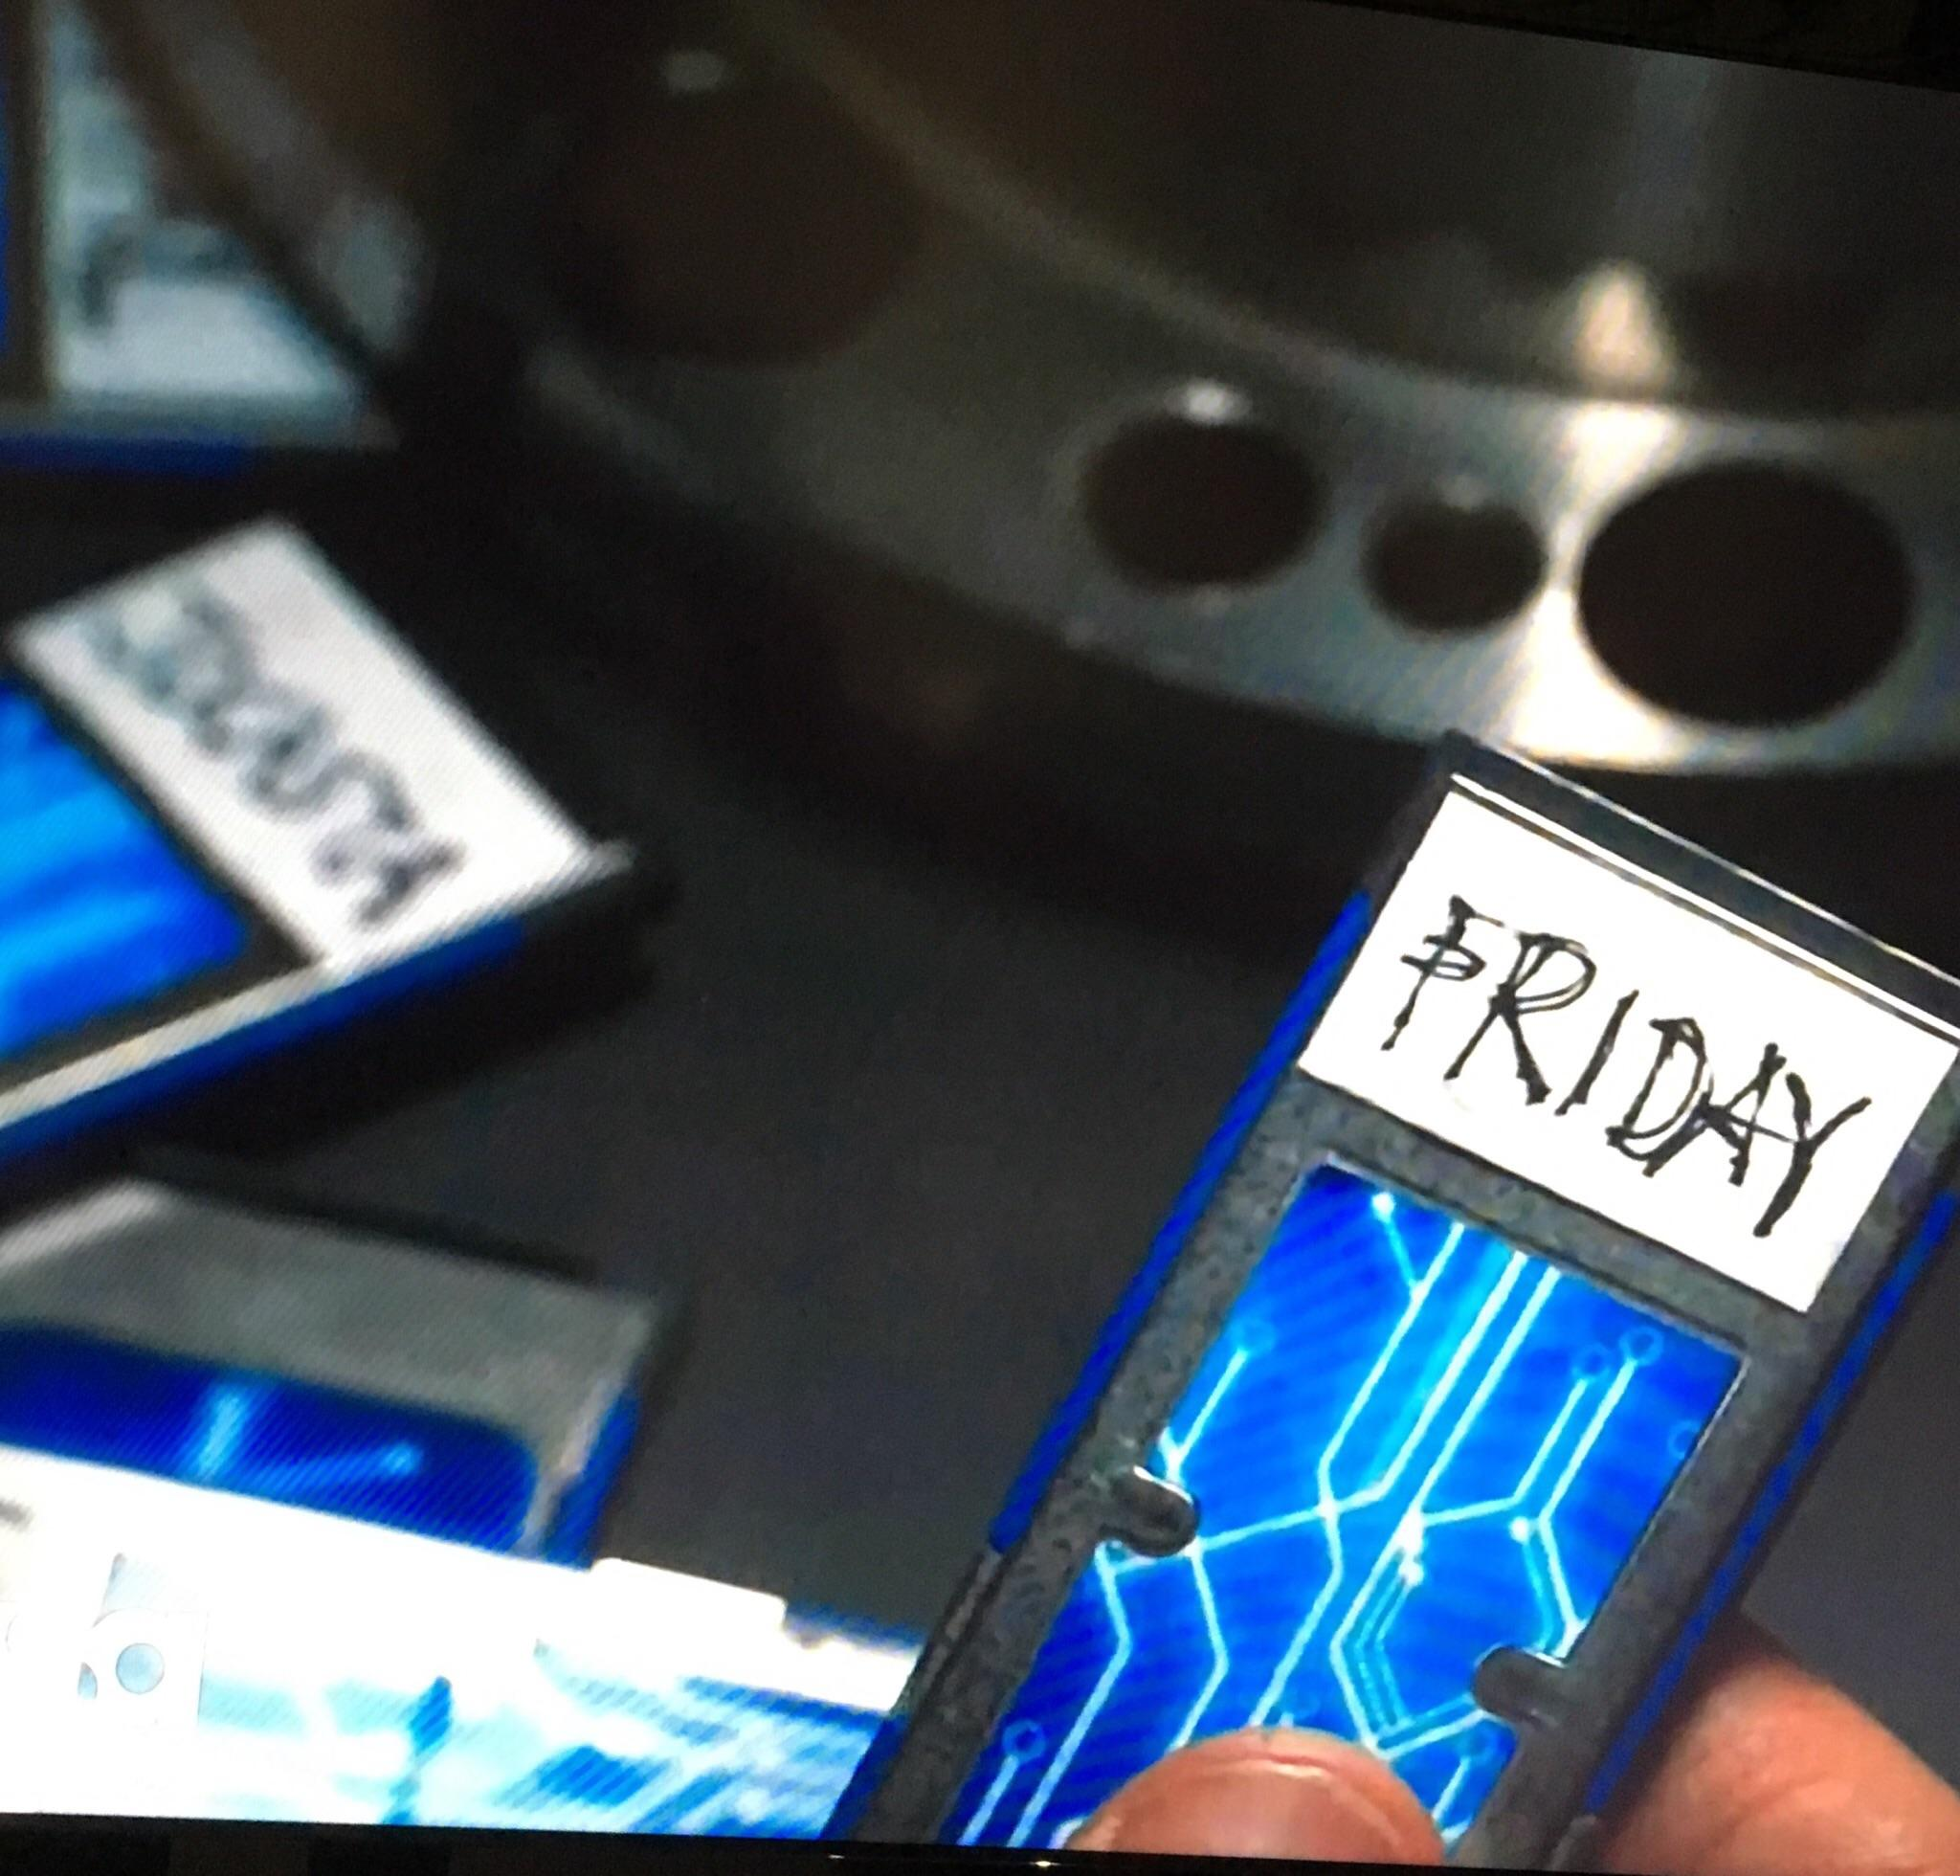
Nomenclature : Motivation and of the Work
Motivation : This name Sat is inspired from World Famous MARVEL Comics characters. Tony Stark replaced JARVIS with FRIDAY due to JARVIS’ AI matrix being integrated with the Vibranium infused artificial body also known as The Vision. So basically SAT is abbreviated from the day name ‘Saturday’ , since I was inspired by Tony Stark and his assistant Friday, I decided to call my assistant SAT.
Scope : Right now I does not implemented any language models like BERT and GPT-3. Because these neural network models can’t be processed using mobile processors.
This can be implemented using Alchemy API but then the idea of on device processing will be gone since it will send the data to google cloud server for processing.

Slide 6
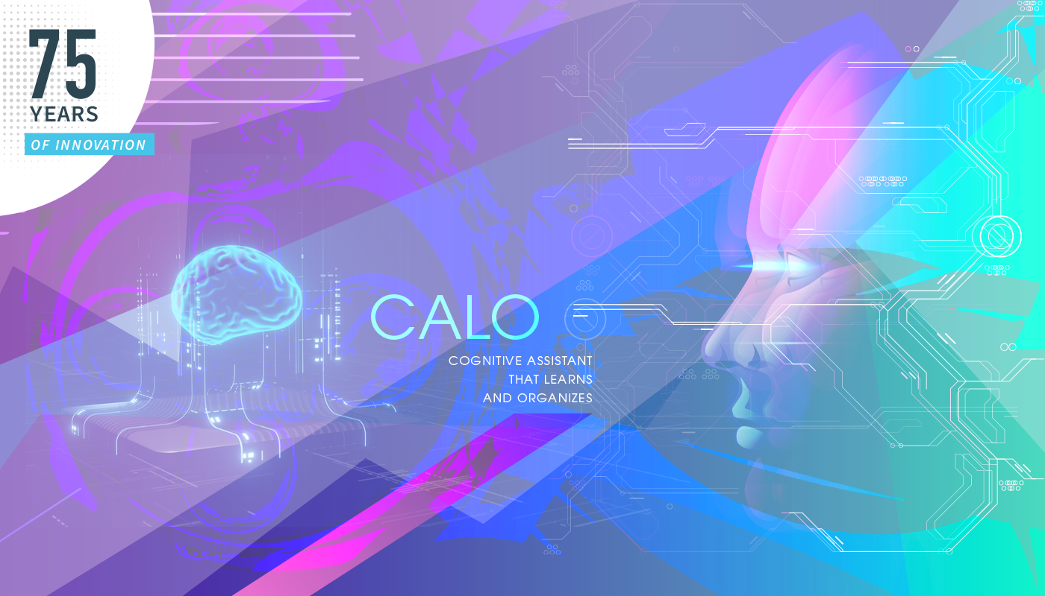
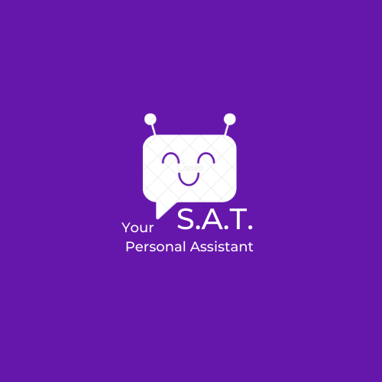


Background and Review Related Work
Background :
The Idea of SAT is inspired from Apple’s virtual assistant Siri. This was
the world’s first virtual assistant that was implemented into mobile. Siri was a
spin-off from the SRI International Artificial Intelligence Center, and an offshoot of
the US Defense Advanced Research Projects Agency's funded CALO project –
an artificial intelligence project that attempted to integrate numerous AI technologies
into a cognitive assistant.
SAT is built completely from scratch in Android Studio.
UI Review :
The UI is completely built from scratch using only one software named
‘Canva’ including the app icon also. How ever the the UI components like the
‘Recycler view’ and color palettes including implementation of Dark mode is built
from ‘Layouts and Values’ in Android Studio. However the dark mode needs some
optimization because it’s not working properly in some devices

Slide 7
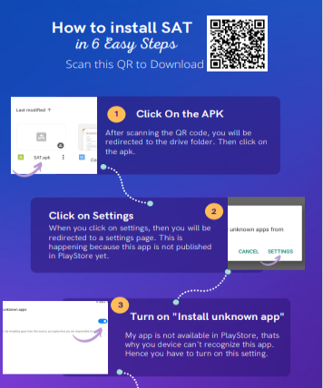
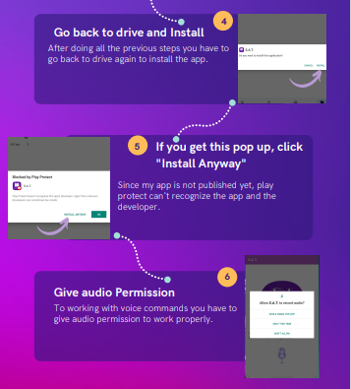
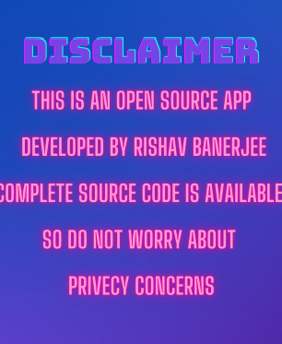
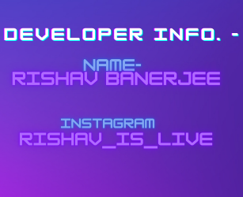

Slide 8
Voice Command Dictionary
Basic
☐ hi / hay / hello
☐ thanks
☐ welcome
☐ ok / okay
☐ clear / clear the screen / clear everything
Advanced
☐ date / what’s the date today / show me the date
☐ time / what’s the time now / show me the time
☐ show weather
☐ phone call
☐ send SMS
☐ read my last SMS
☐ call
☐ capture photo
☐ play ringtone
☐ stop ringtone
App Opening
☐ open Gmail
☐ open WhatsApp
☐ open Facebook
☐ open Messages
Bluetooth
☐ turn on Bluetooth
☐ turn off Bluetooth
☐ get Bluetooth devices
ClipBoard
☐ copy to clipboard
☐ read last clipboard
Torch / Flash
☐ turn on flash
☐ turn off flash
Sharing
☐ share a file
☐ share a text message

Slide 9

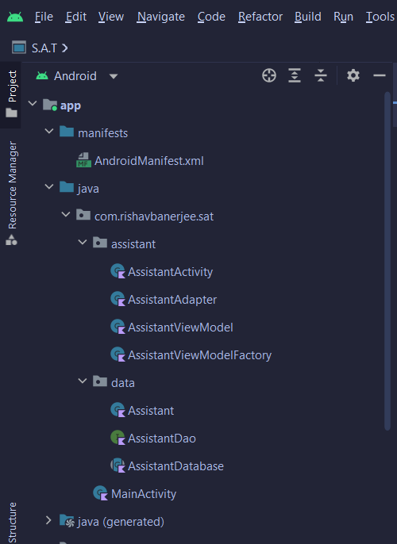
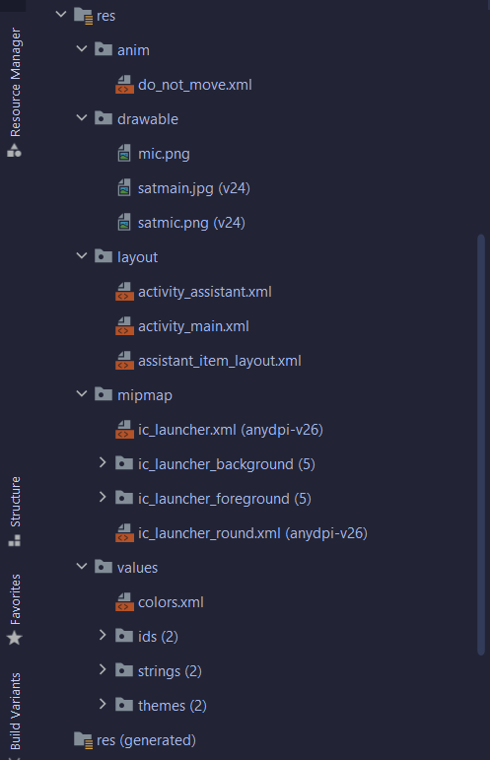
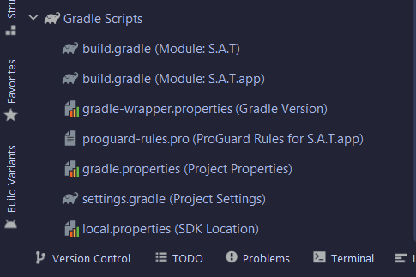
Project Code Structure :

Slide 10
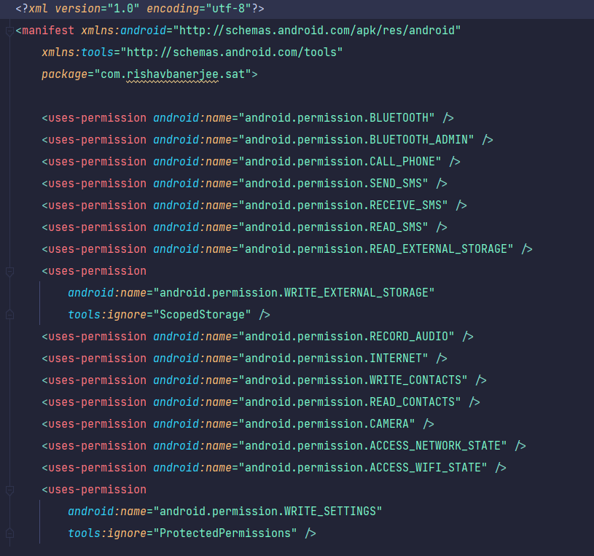
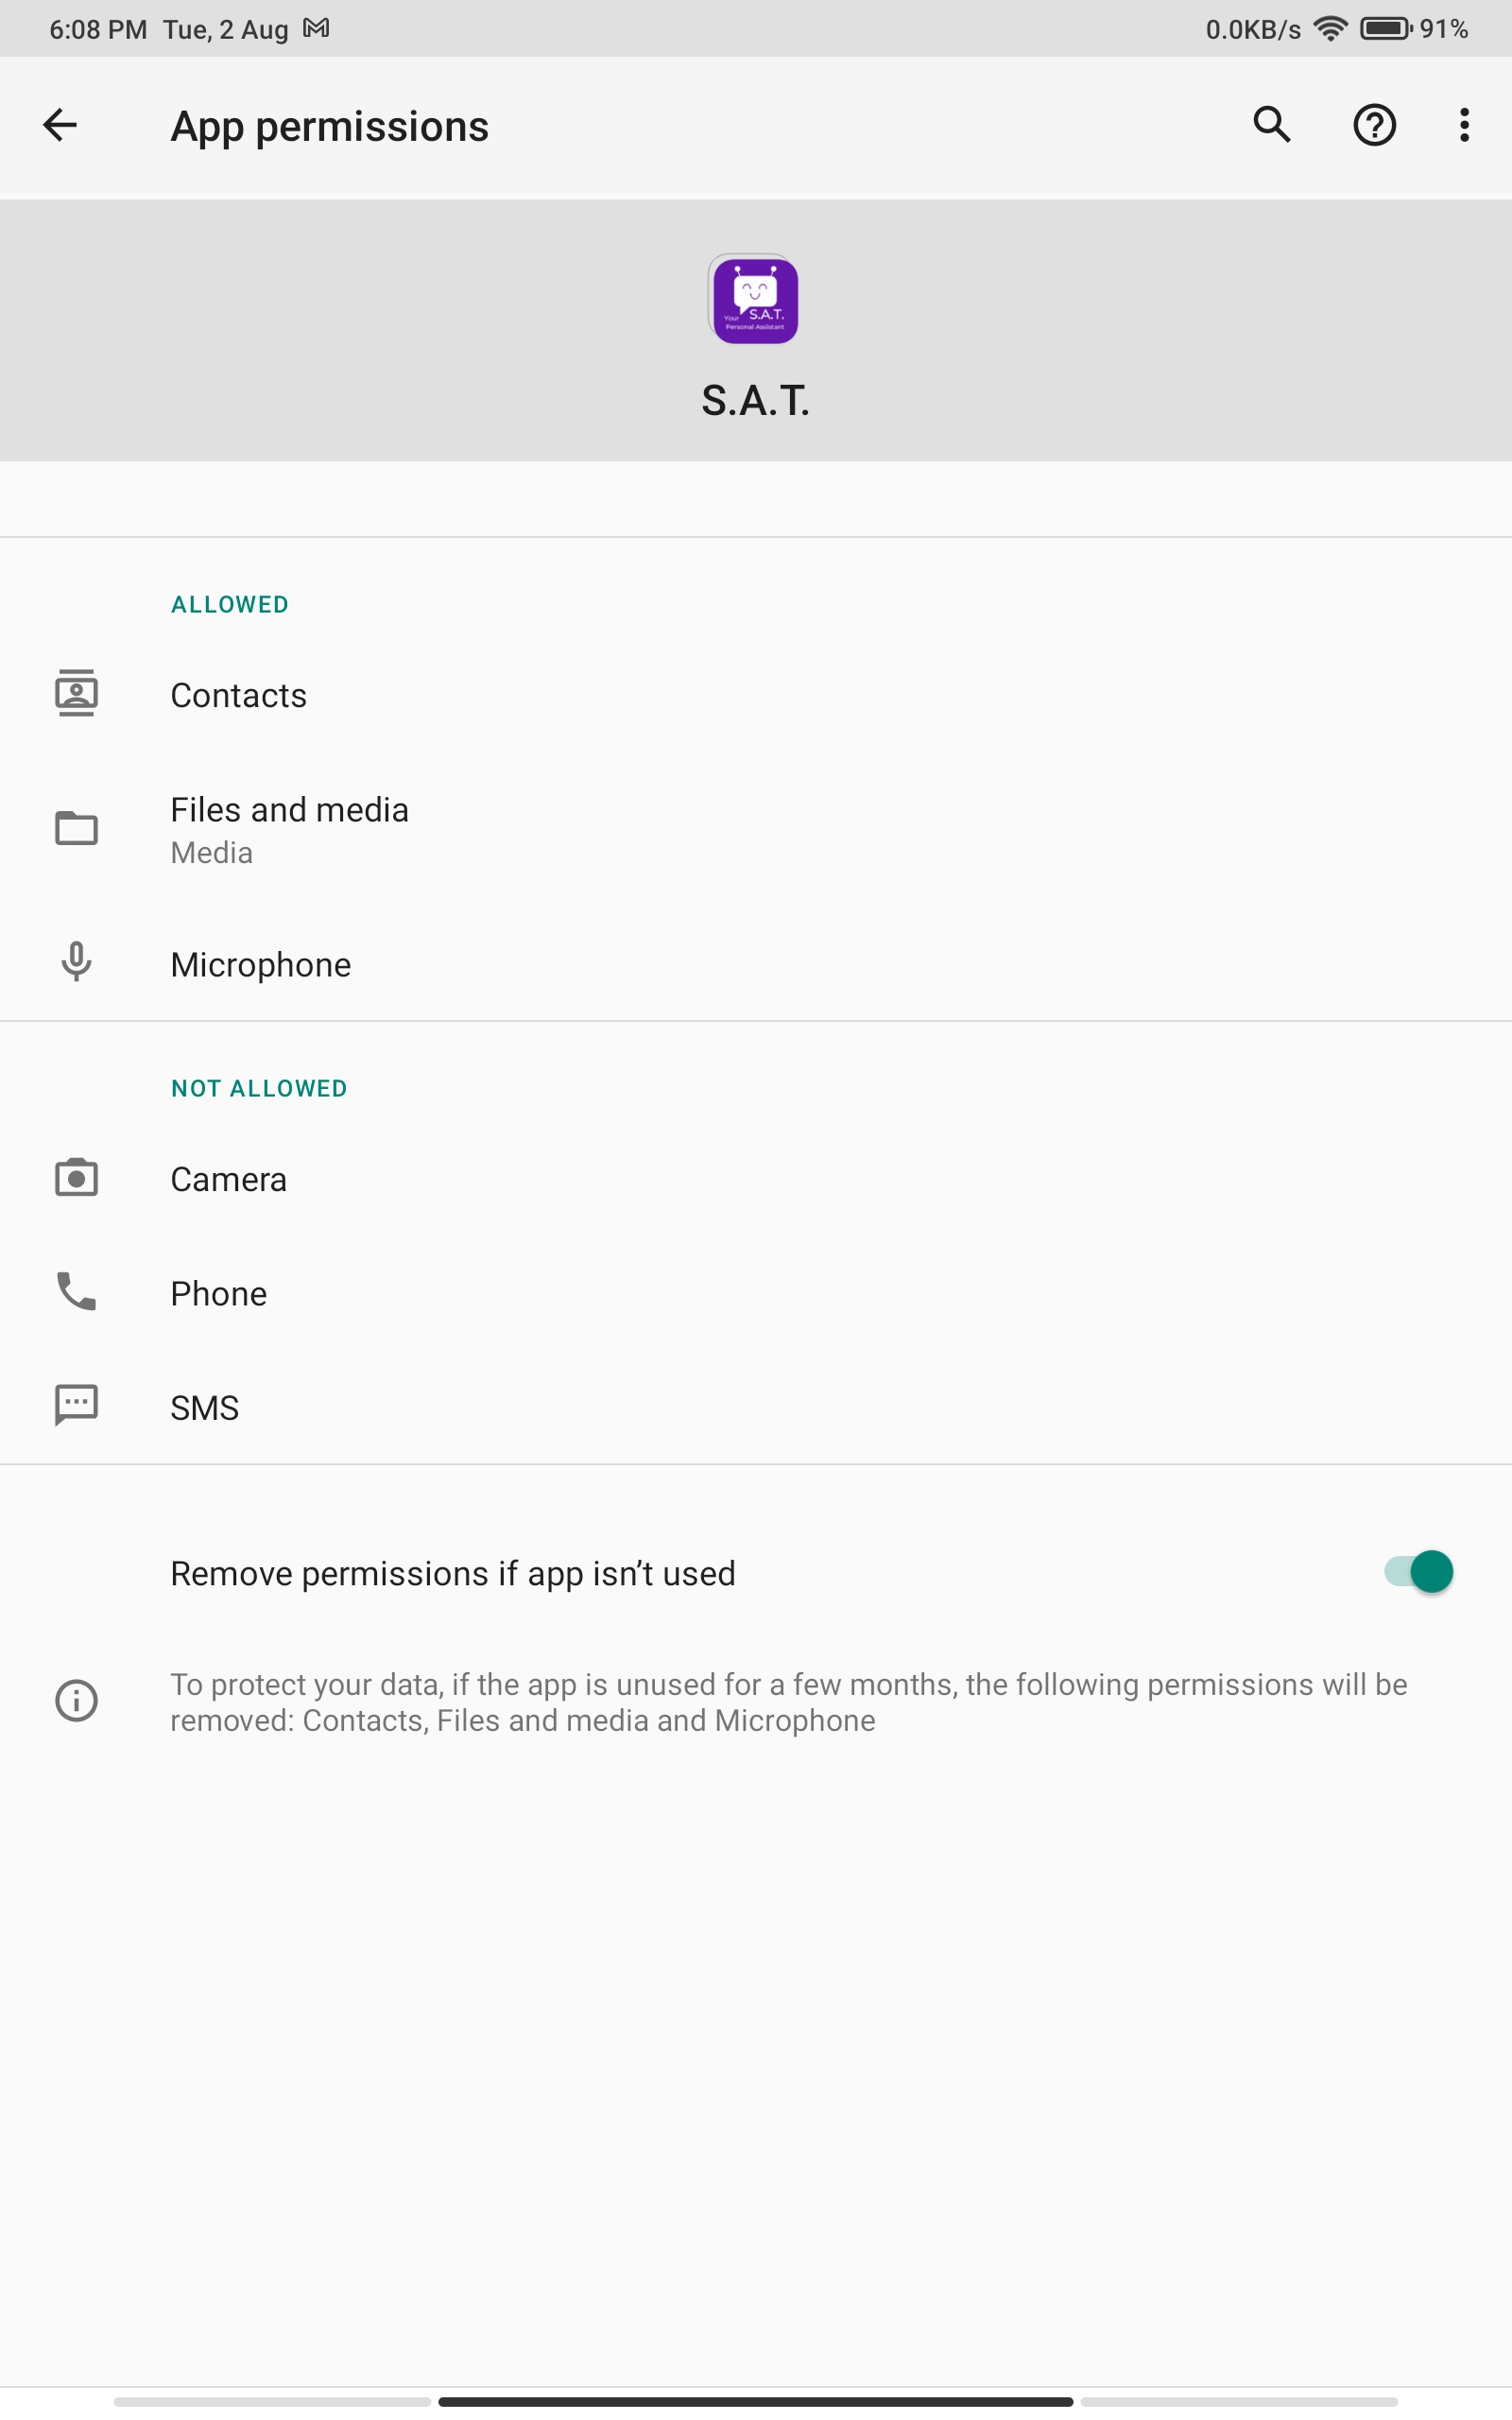
Service Permissions :

Slide 11
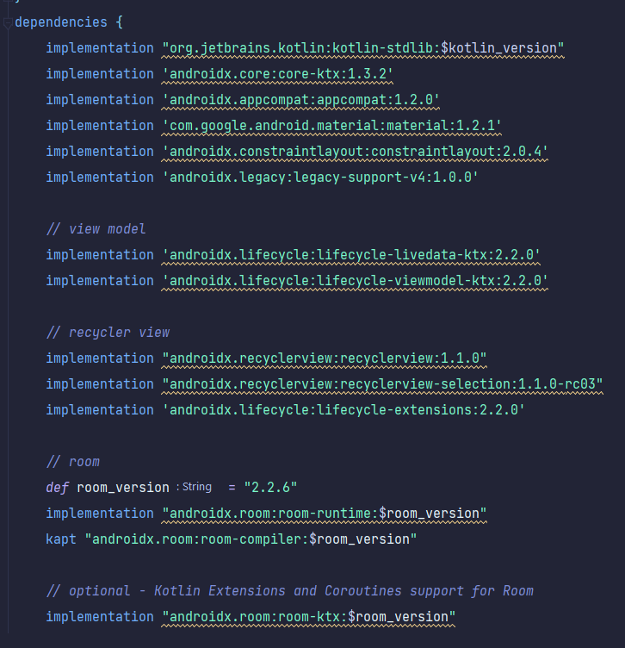
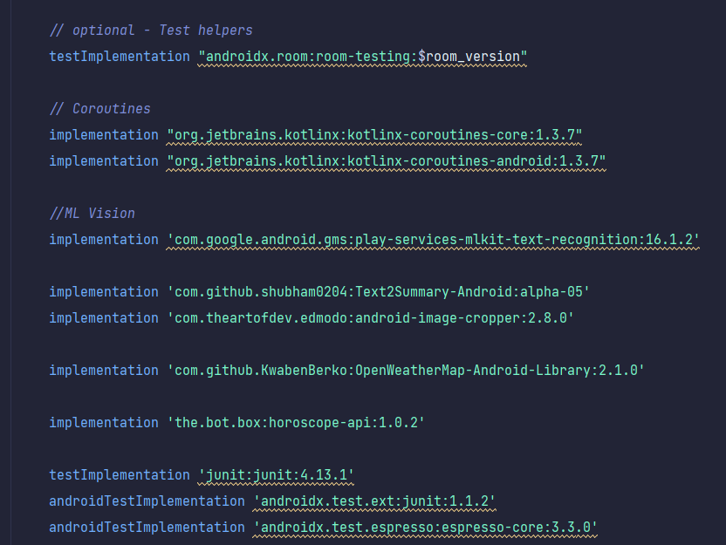
Dependencies and APIs:

Slide 12
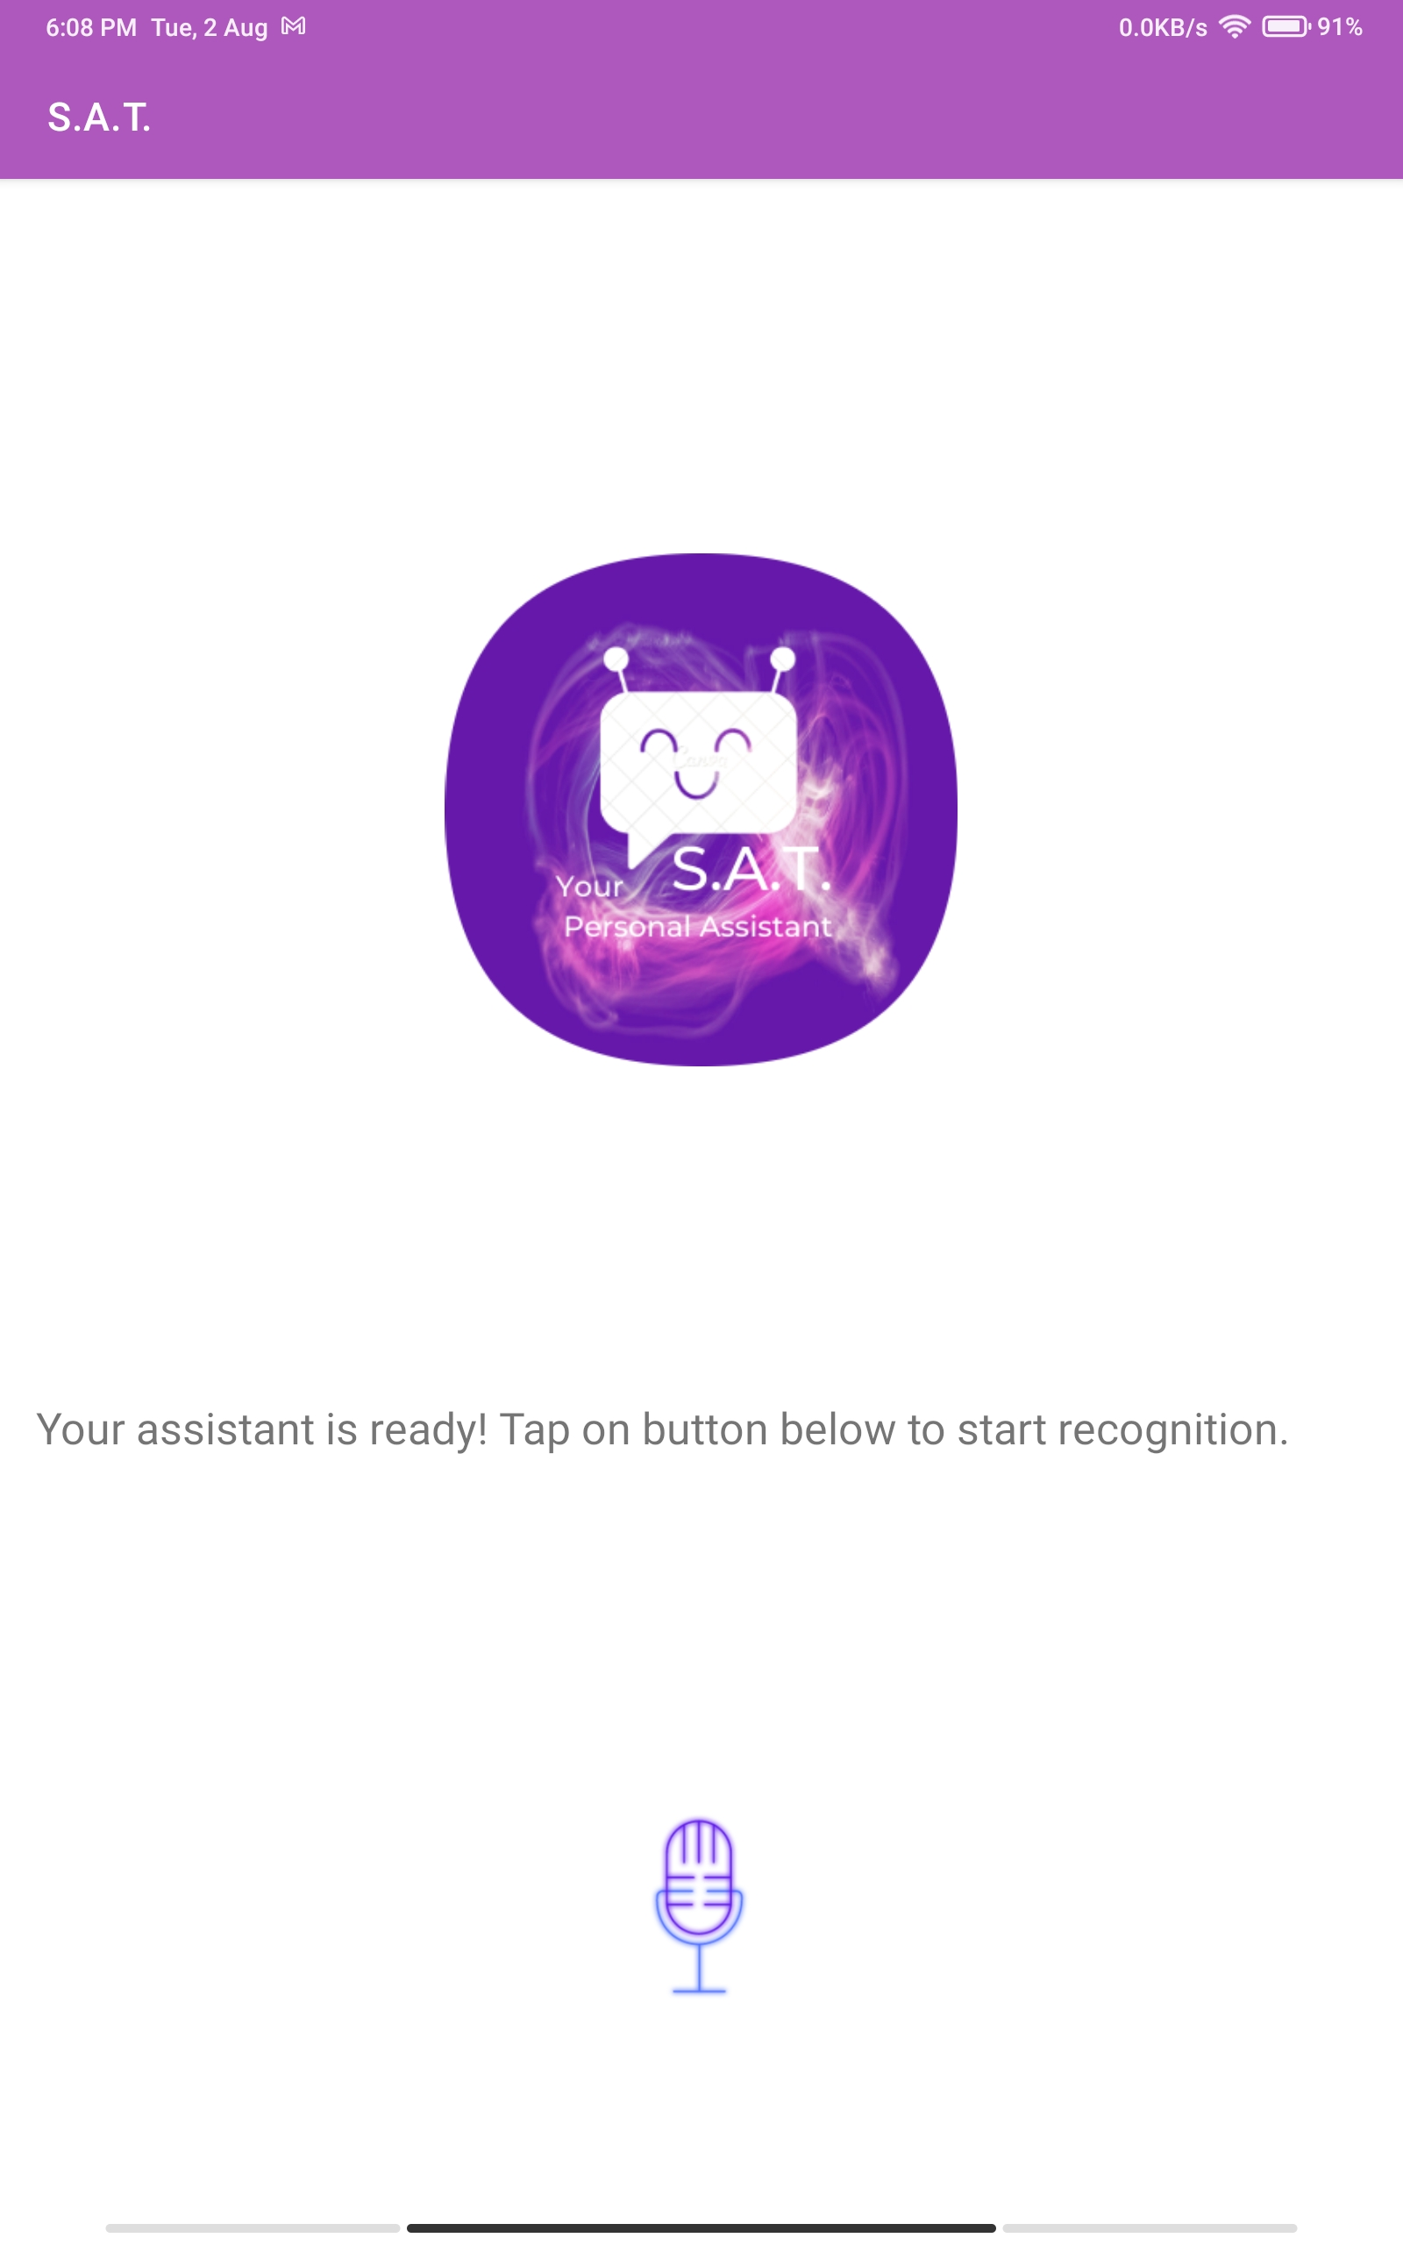
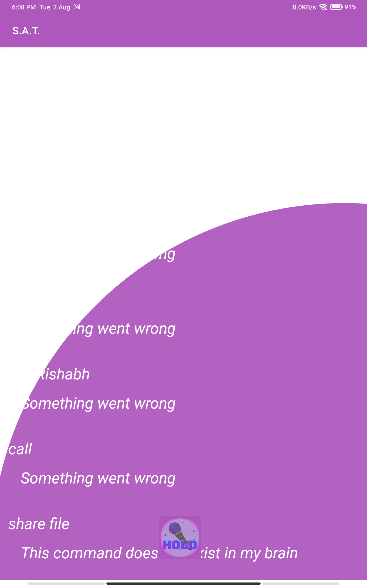
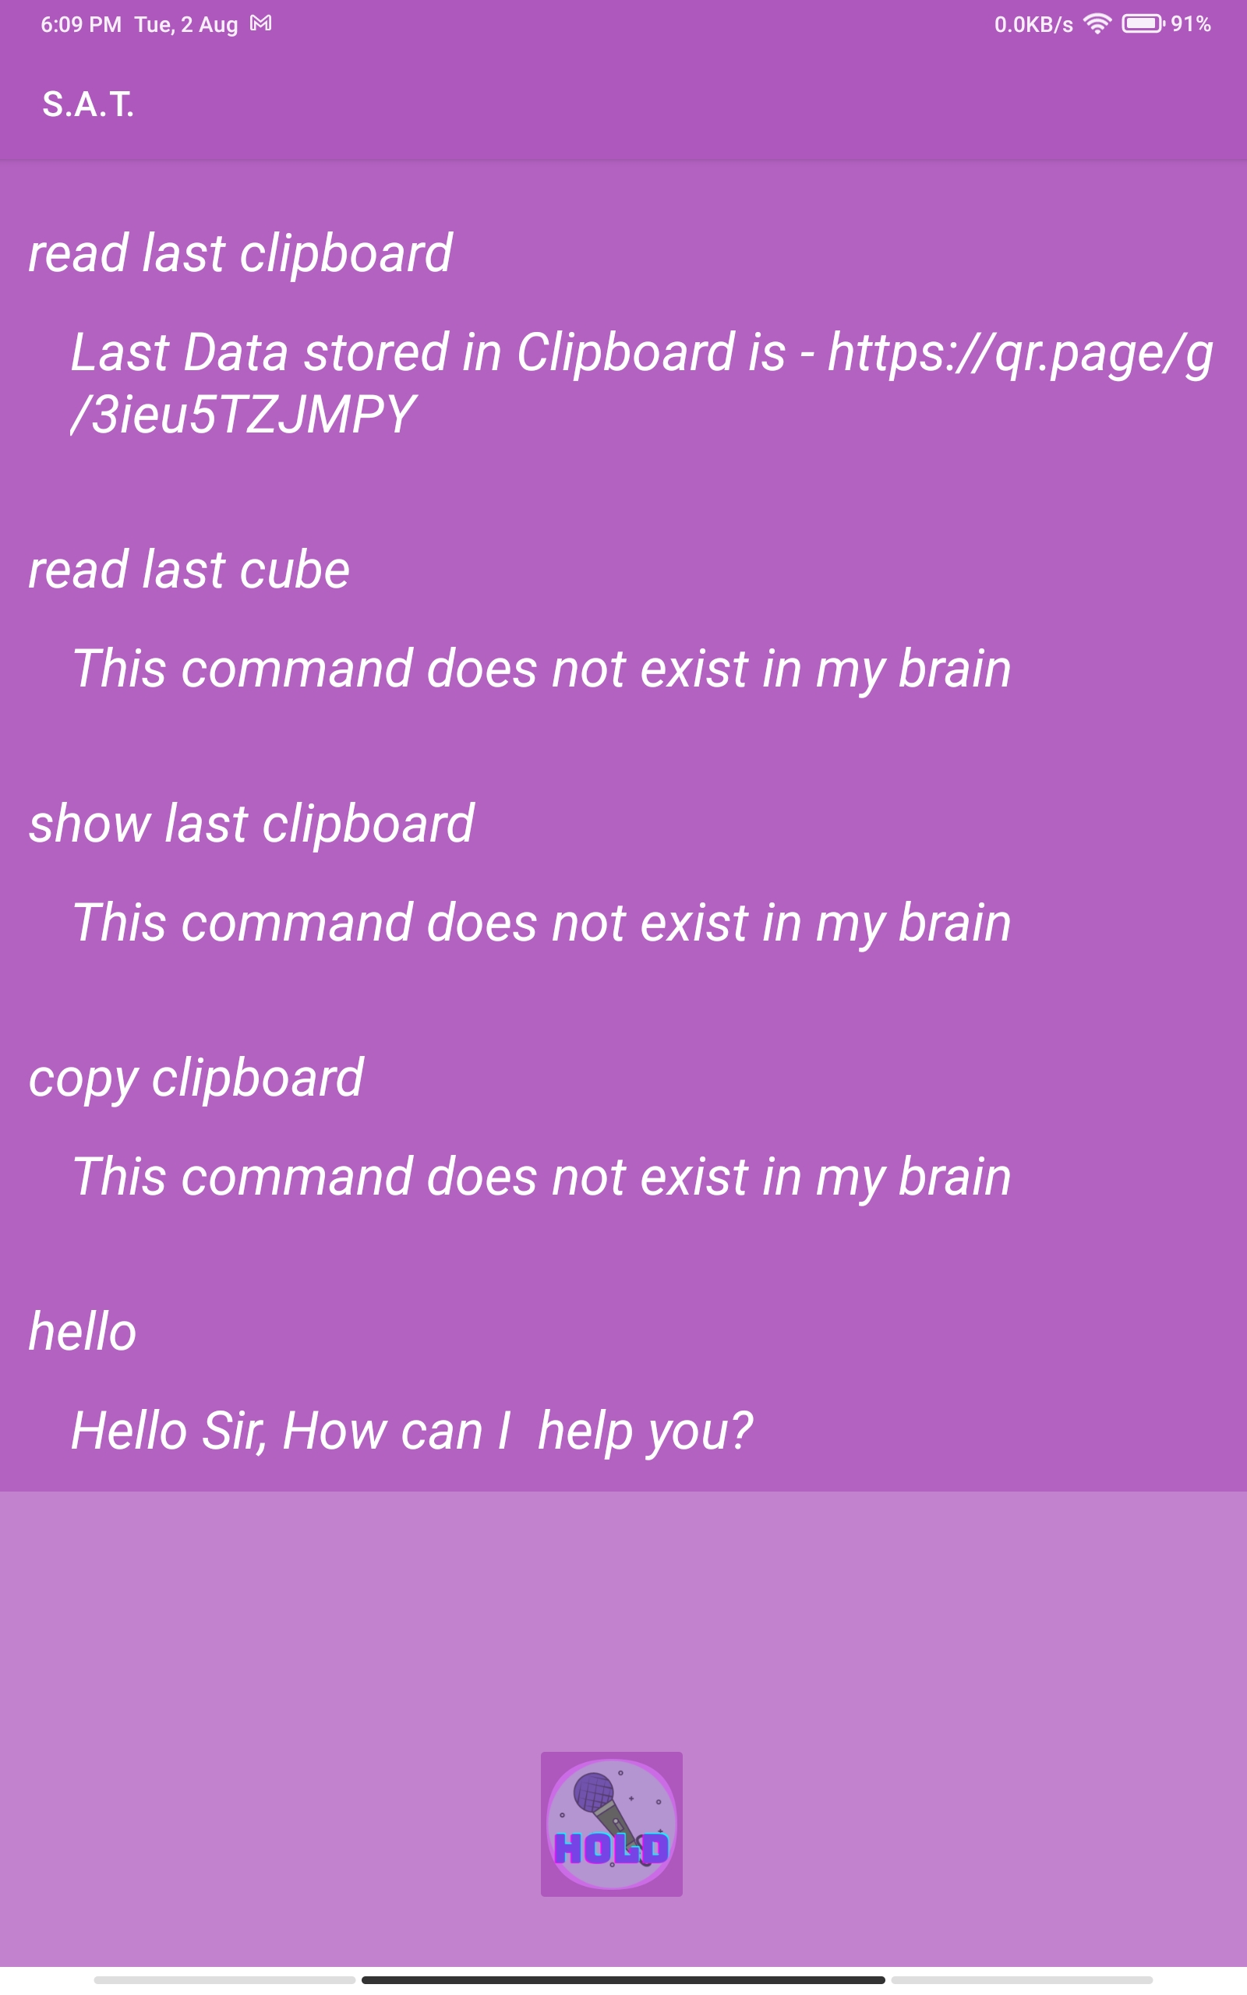
Implementation : Few Examples
Main UI
Transition
Voice UI

Slide 13
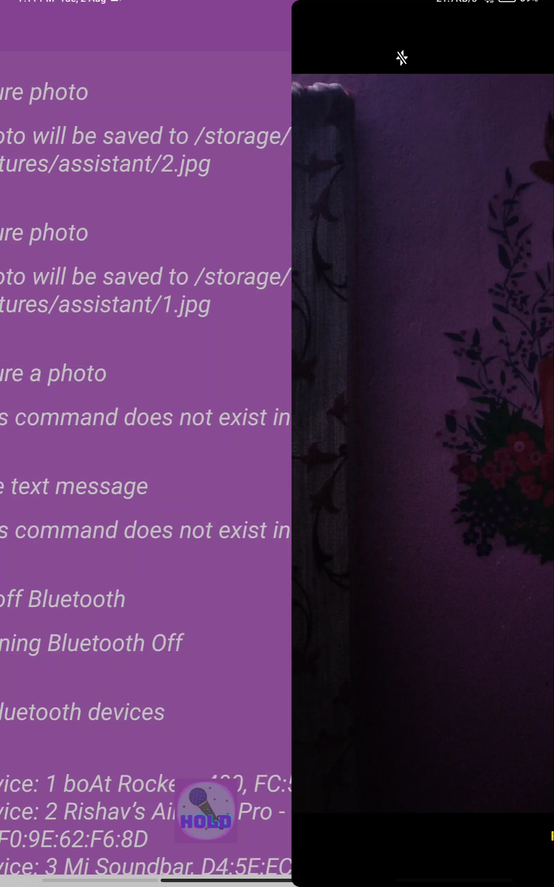
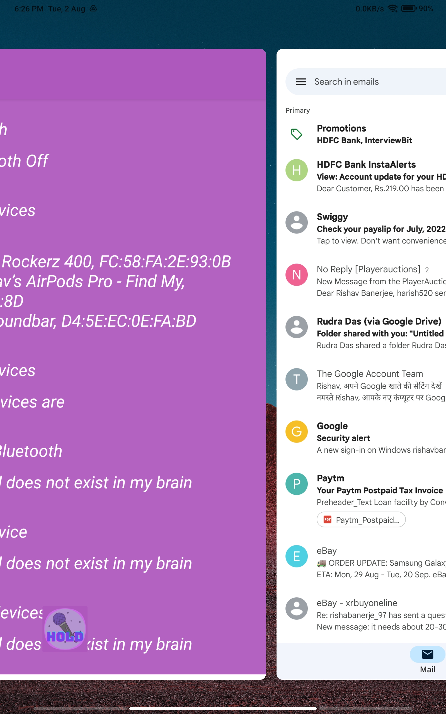
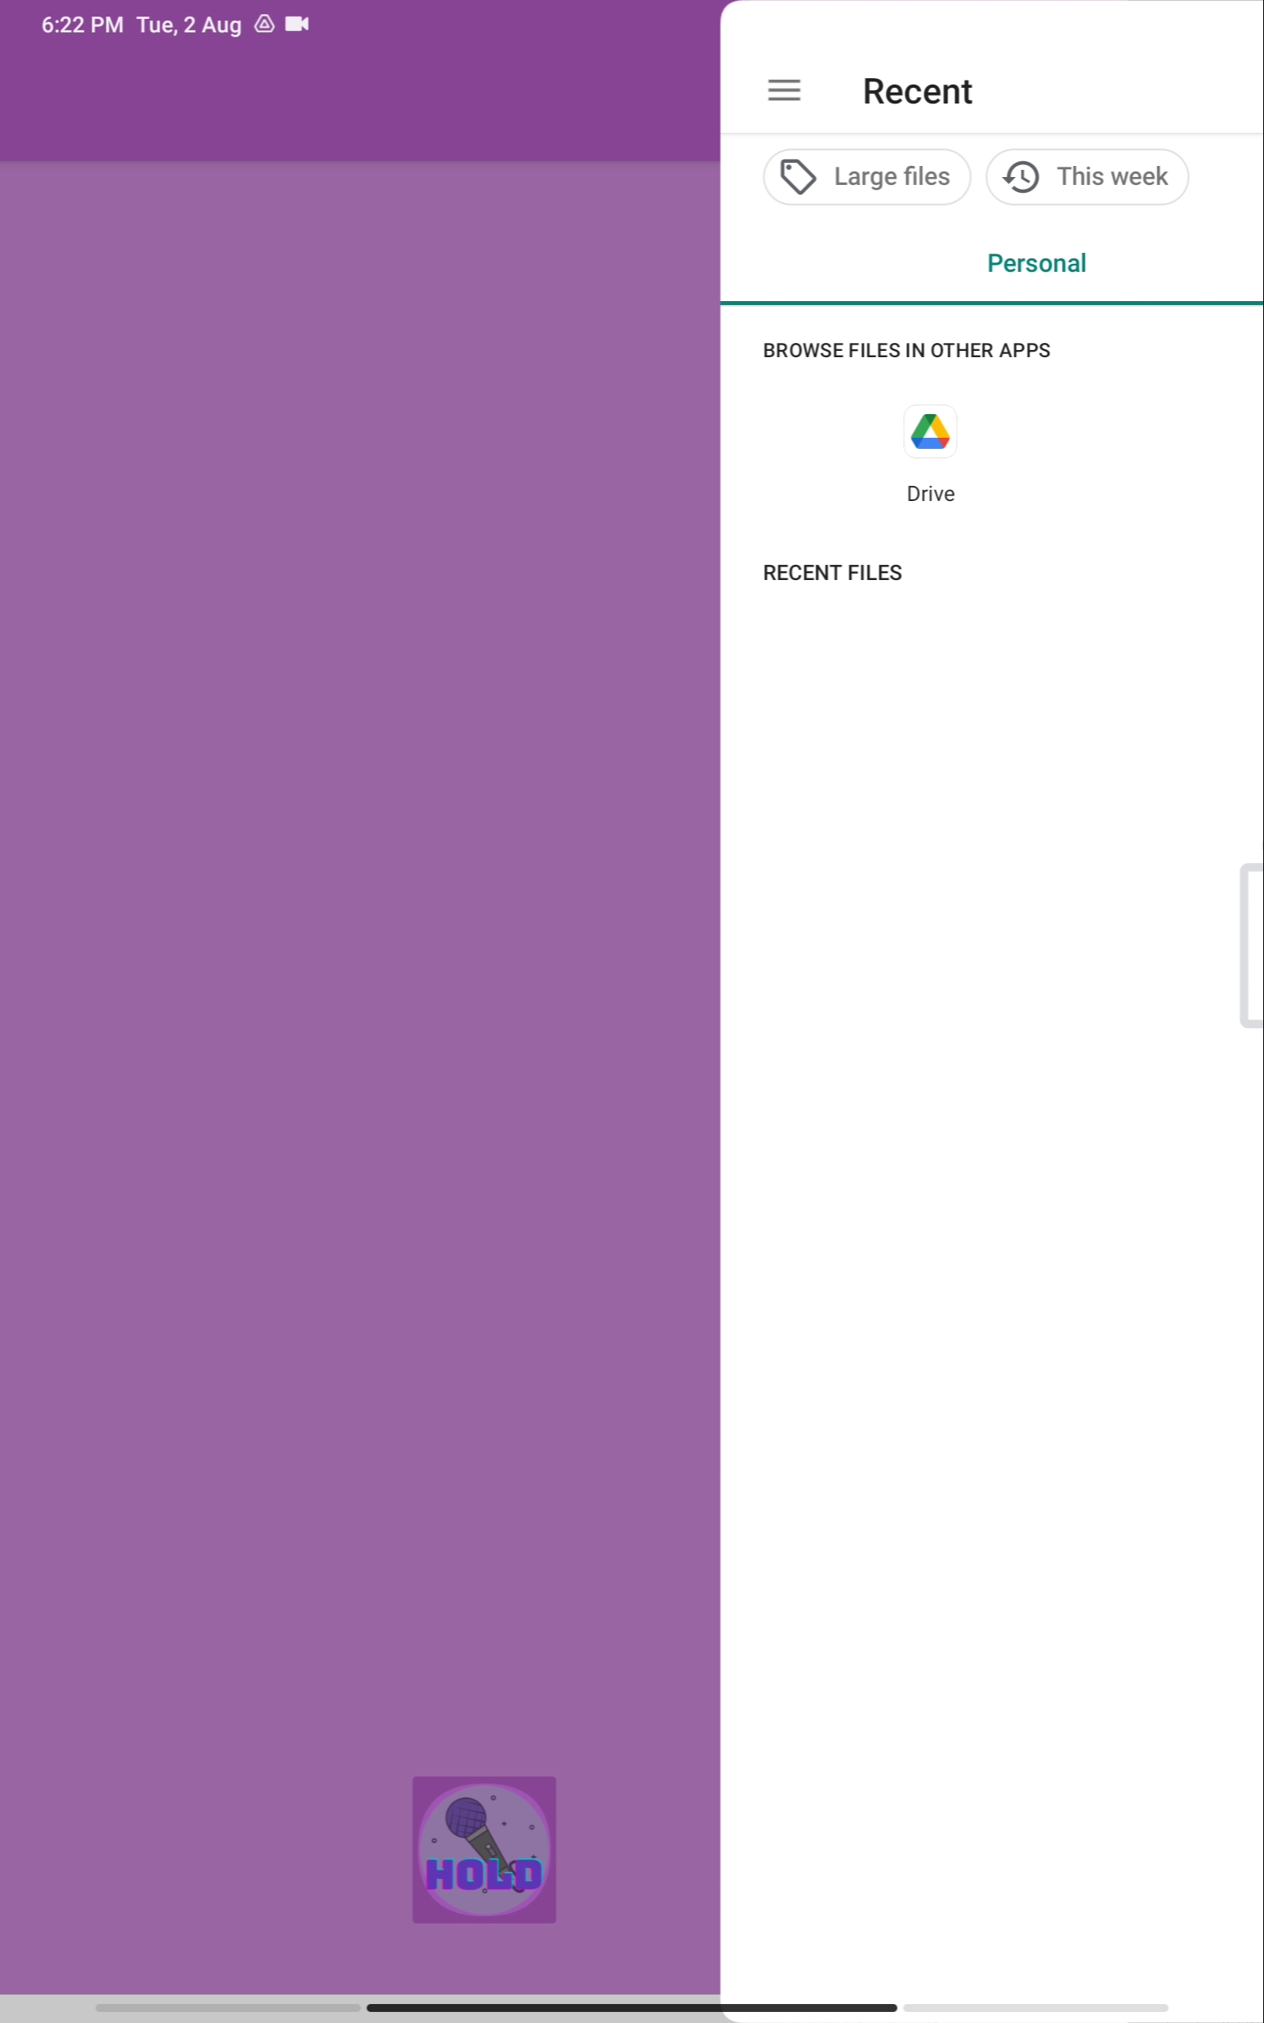
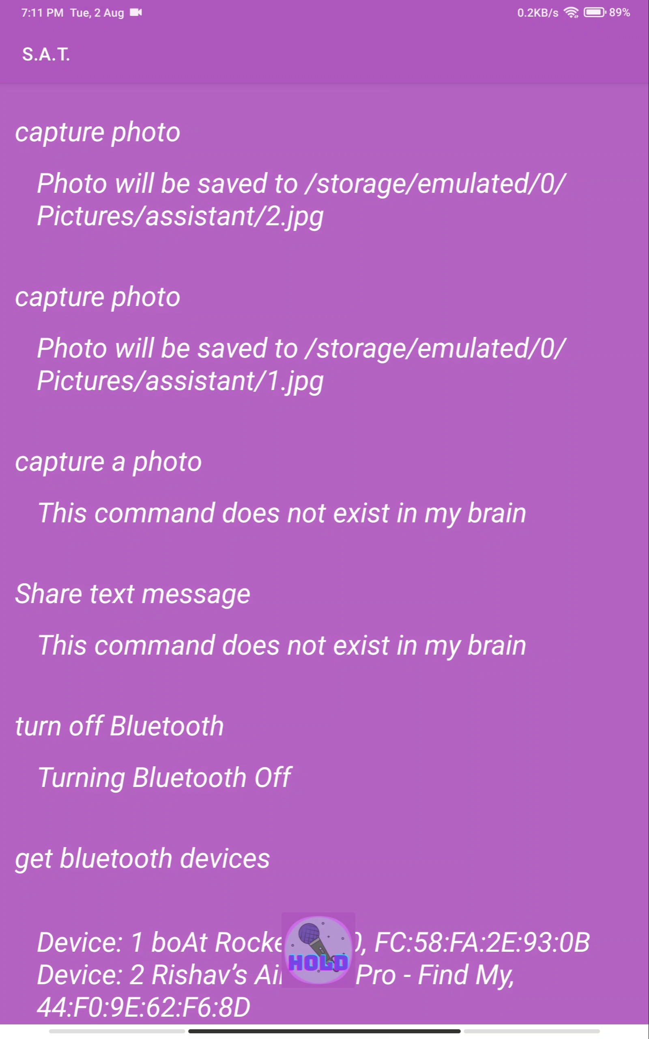
Capture photo
Open Gmail
Share File

Slide 14
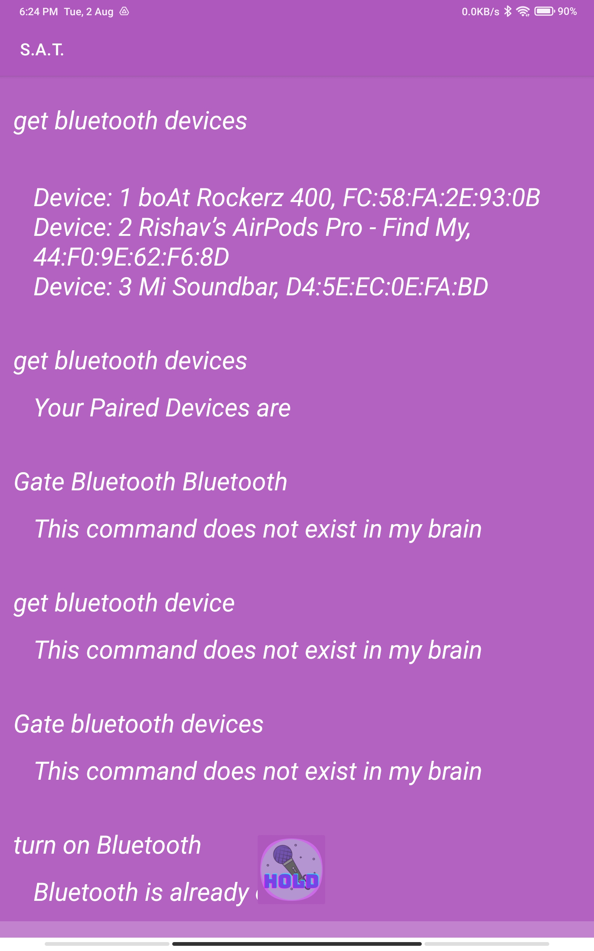
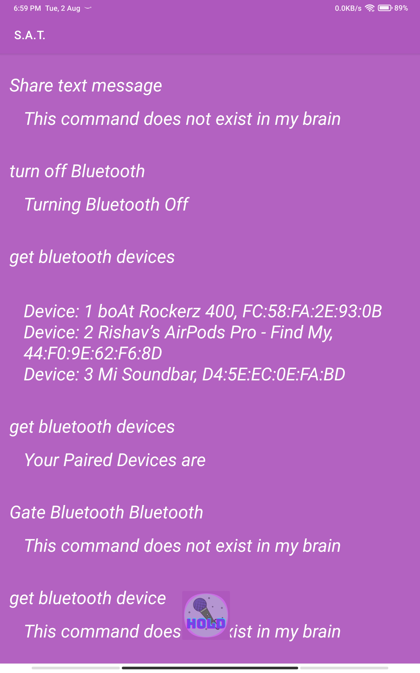
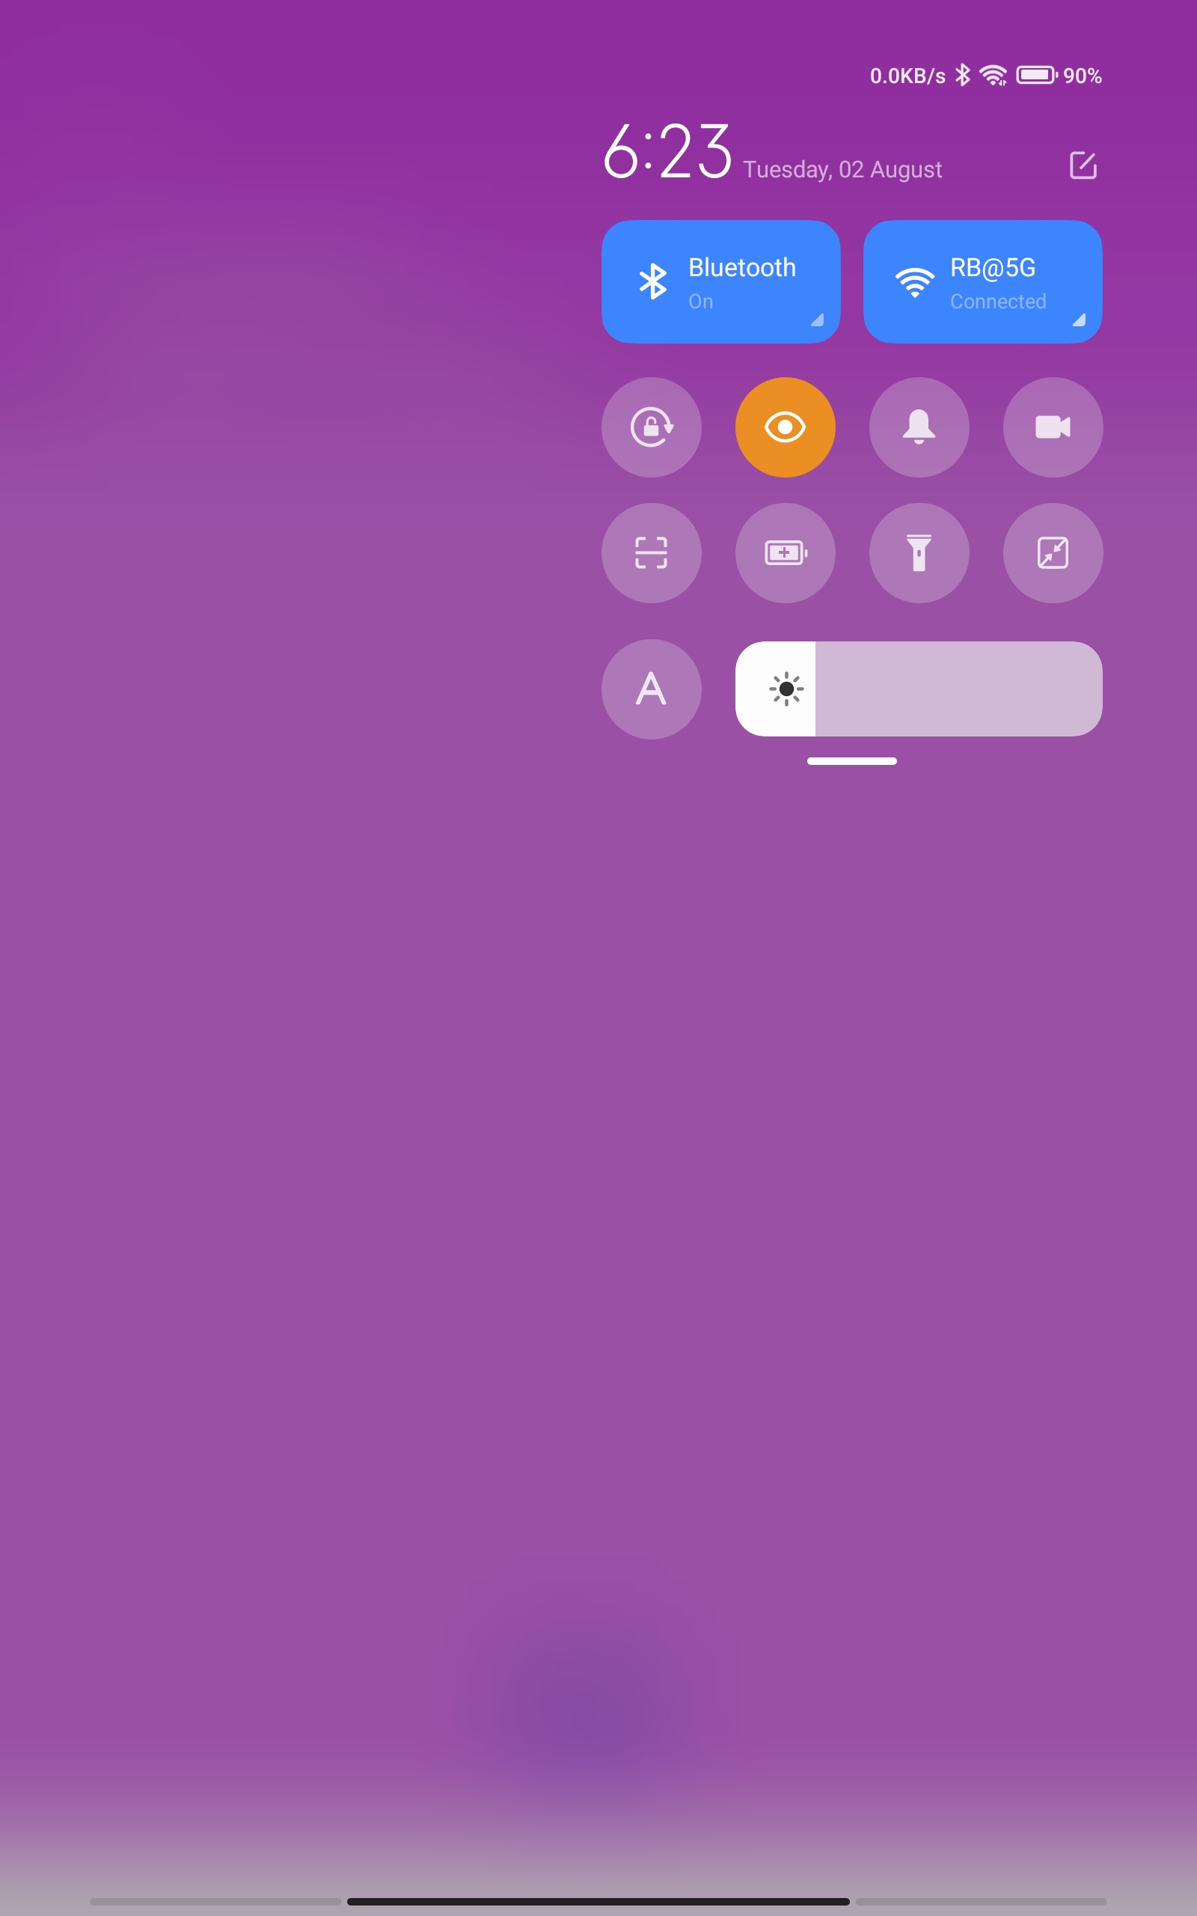
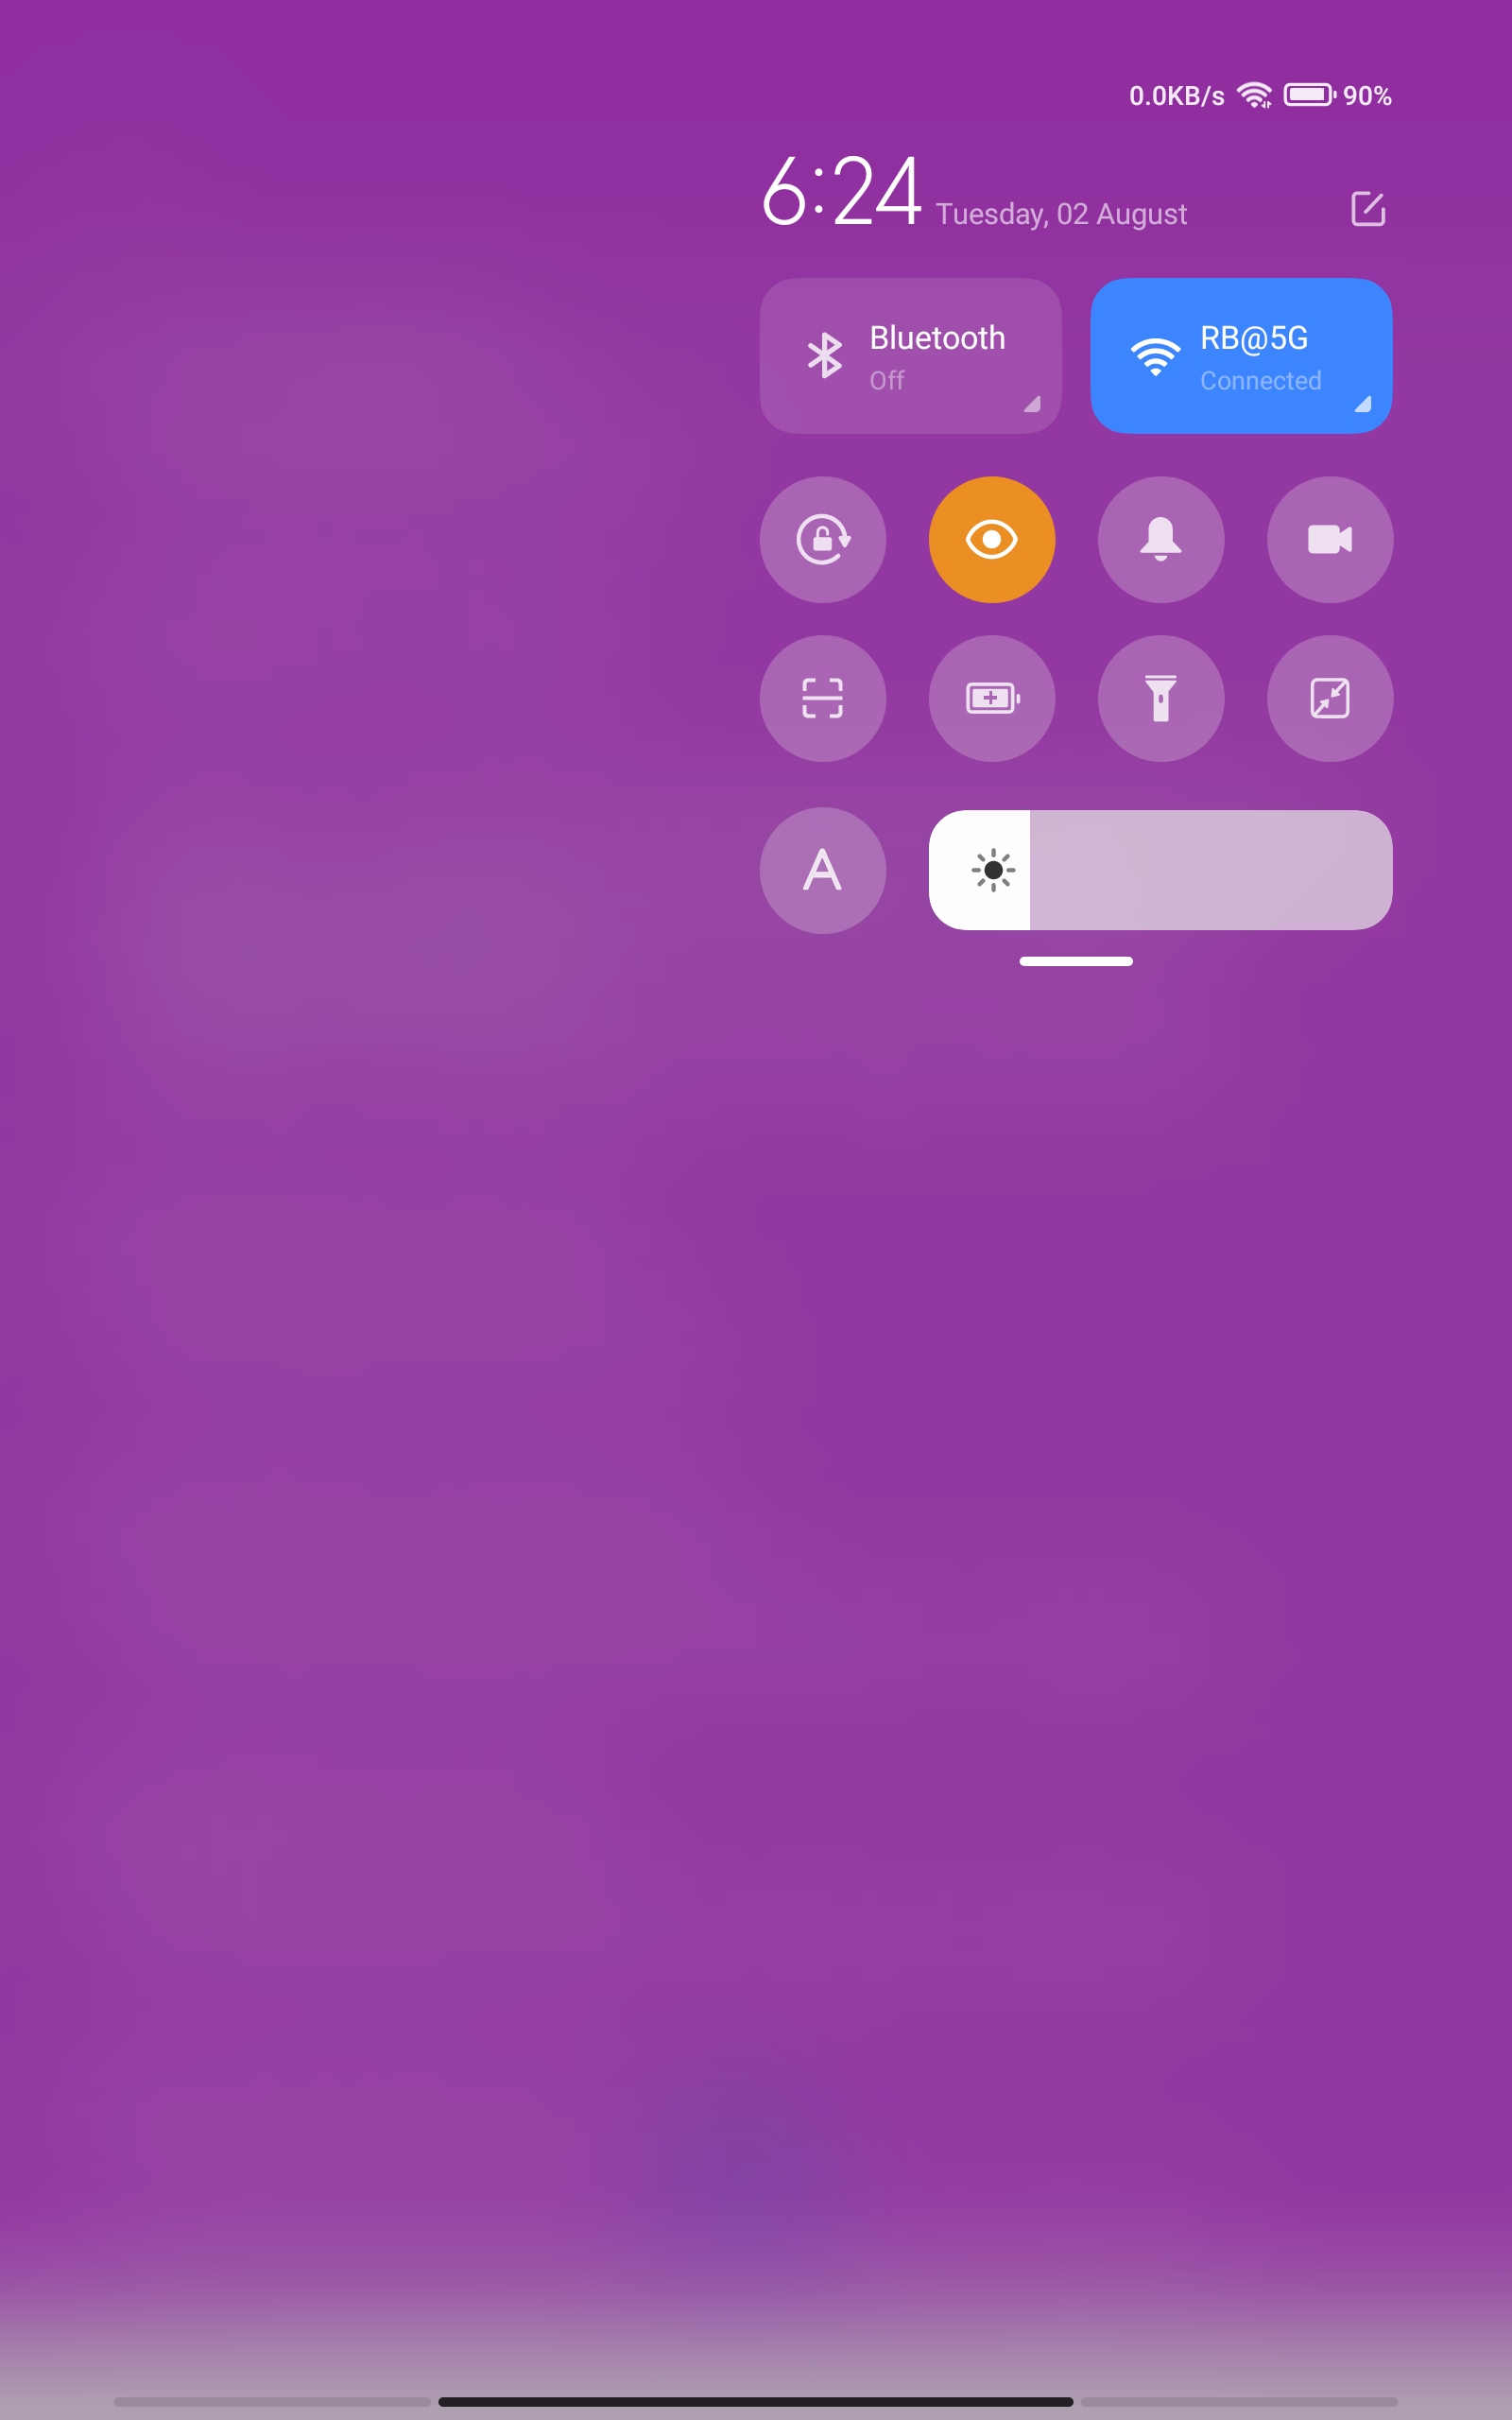
Bluetooth Devices

Slide 15
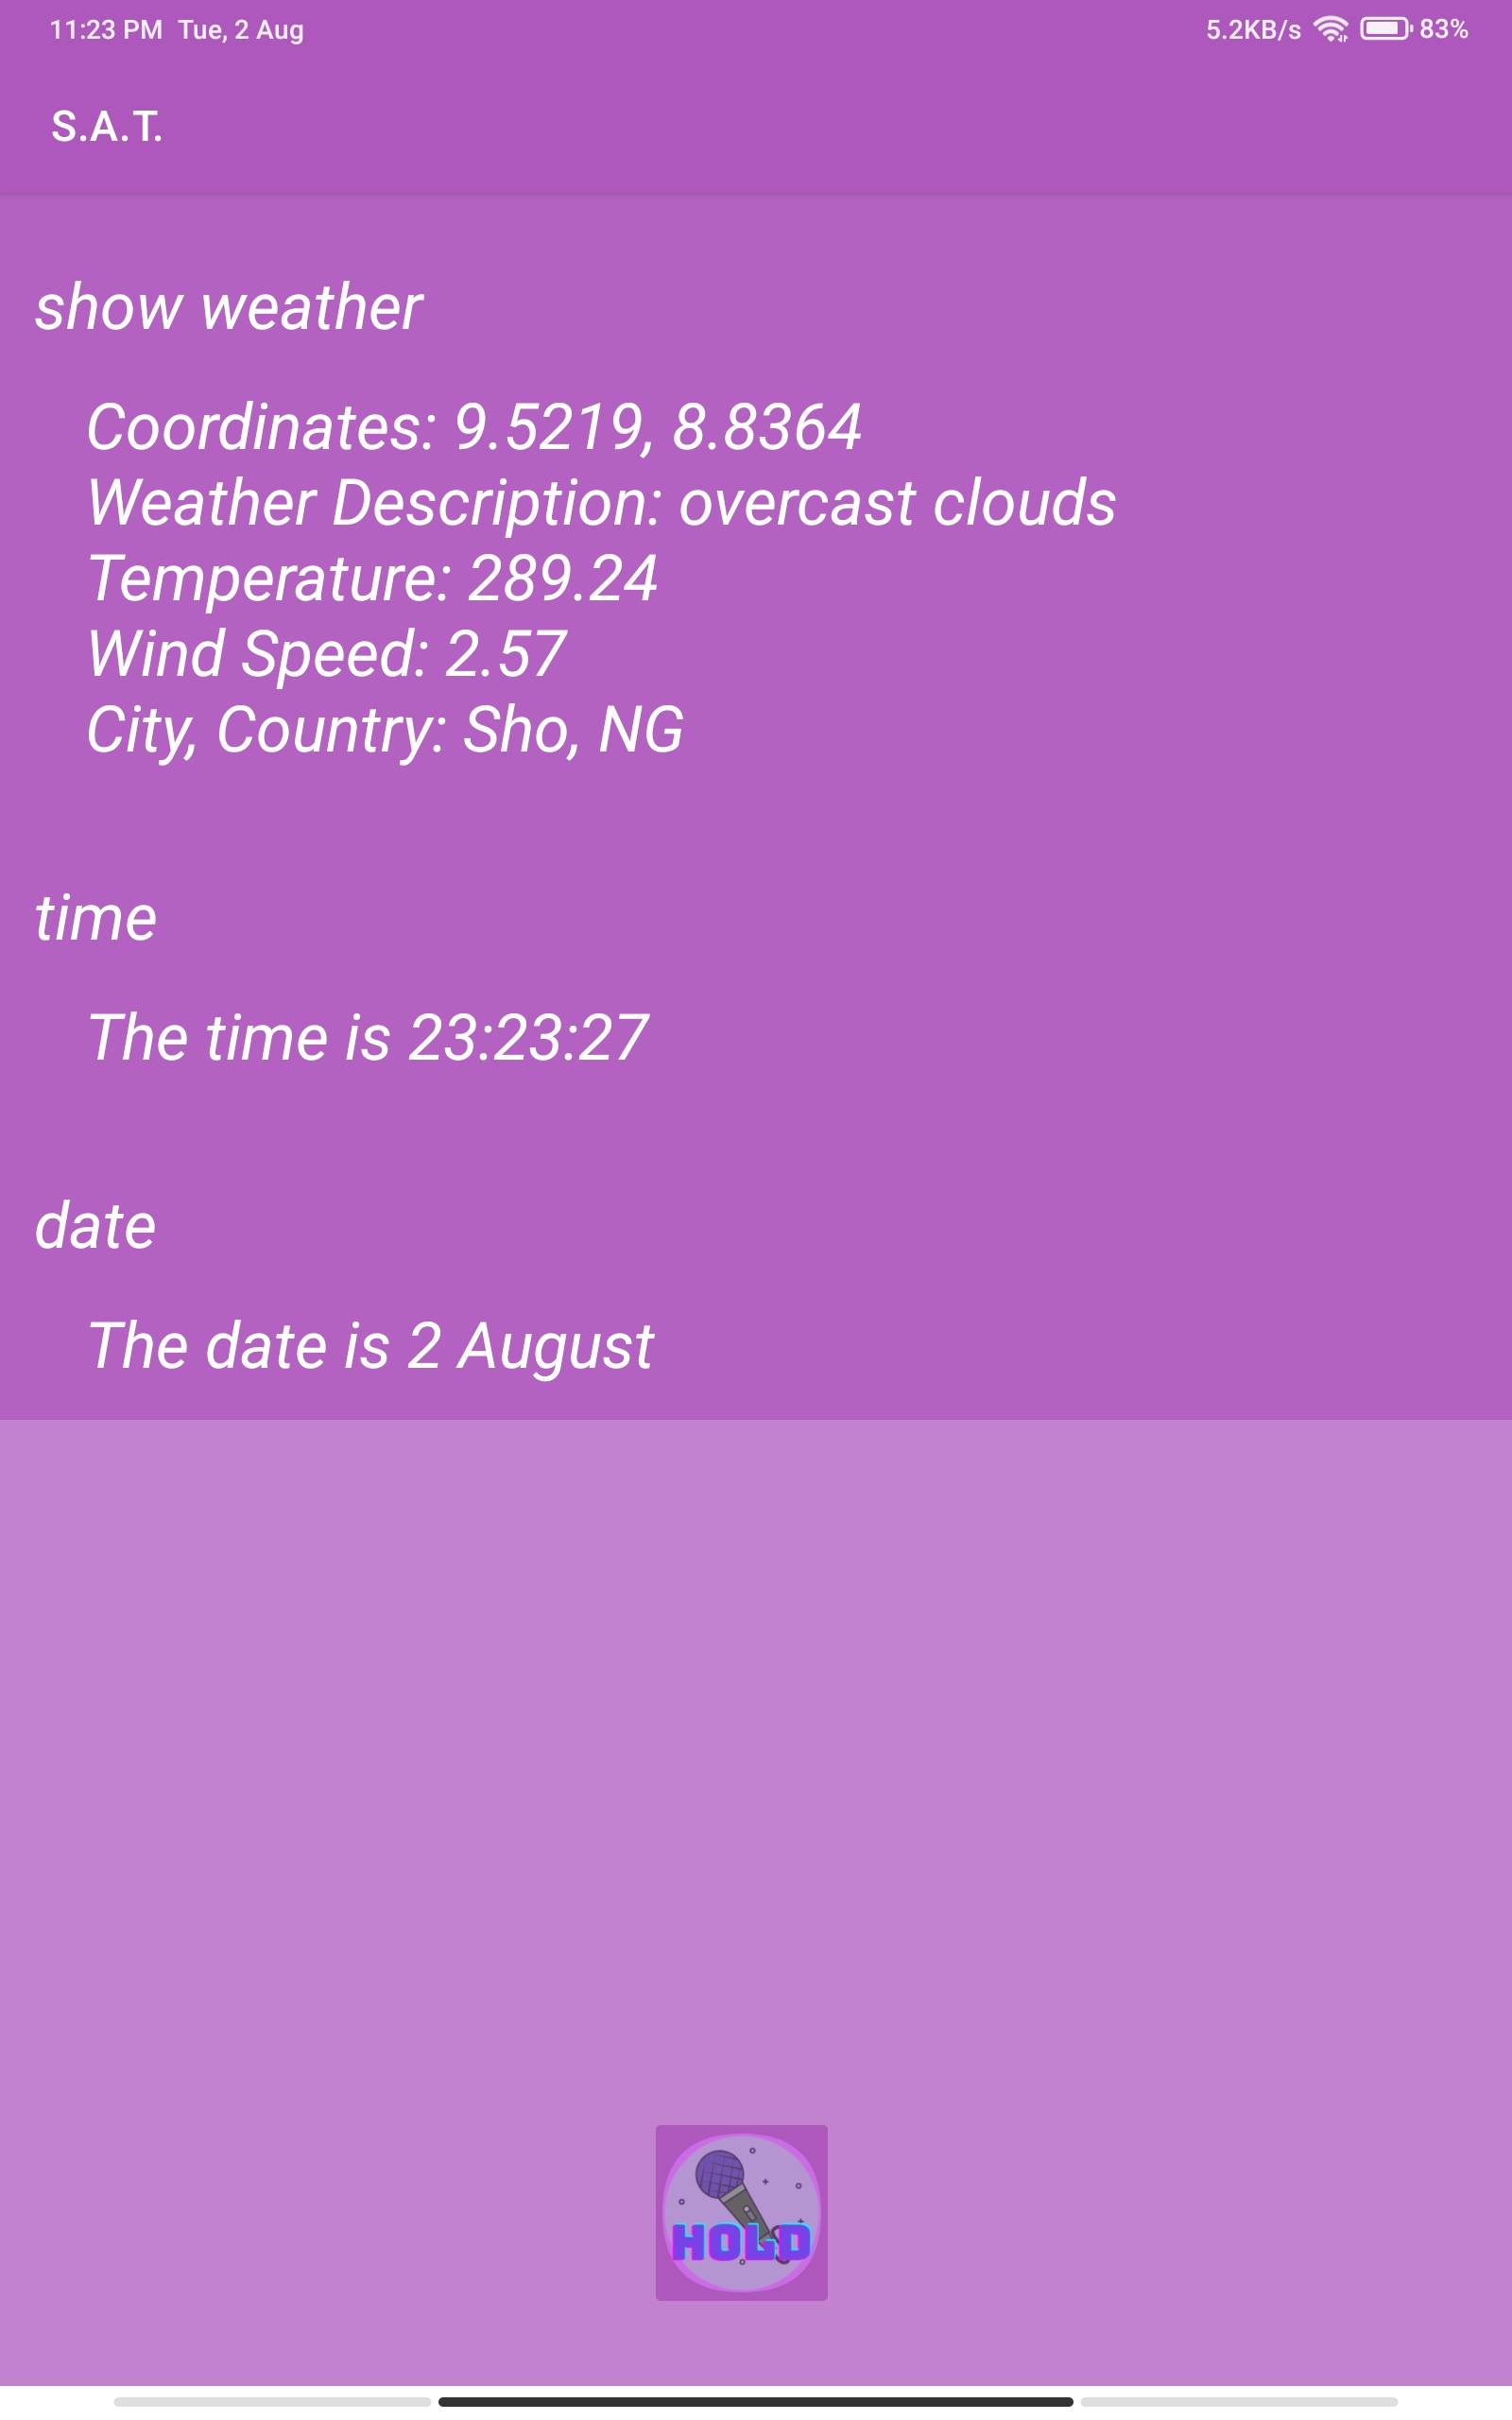
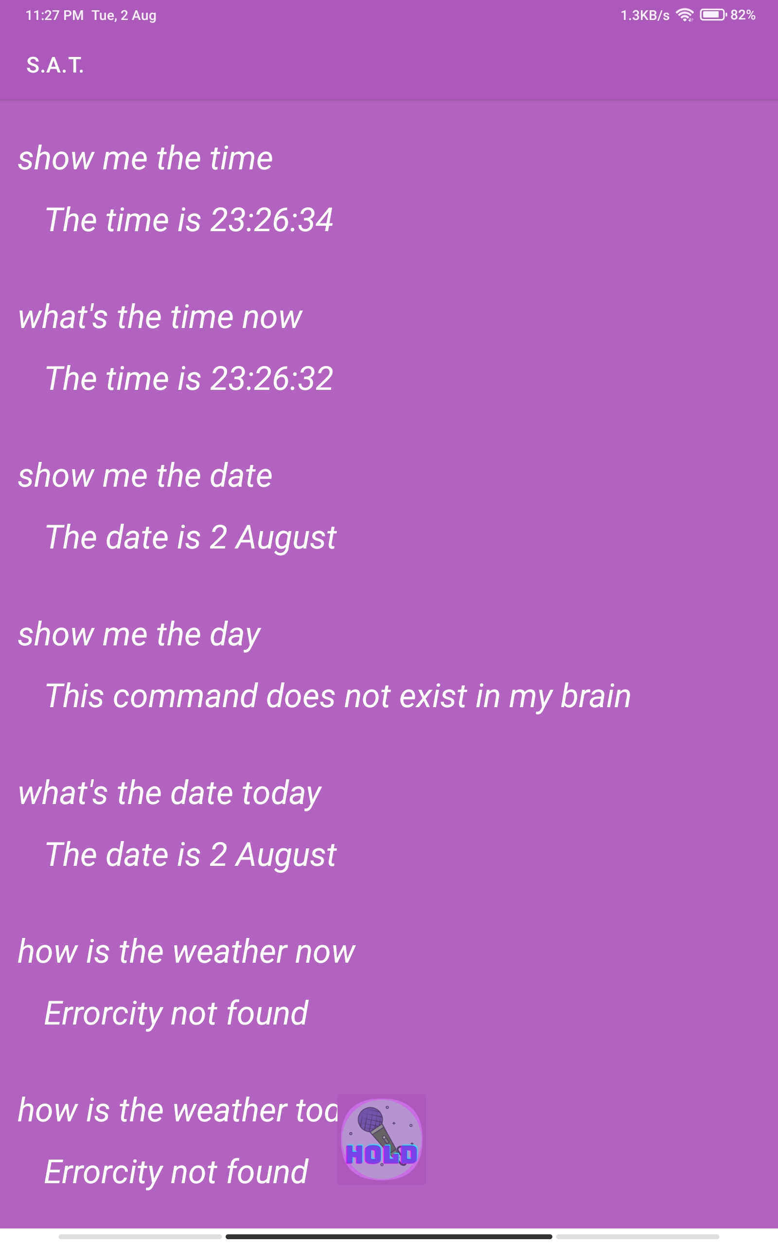
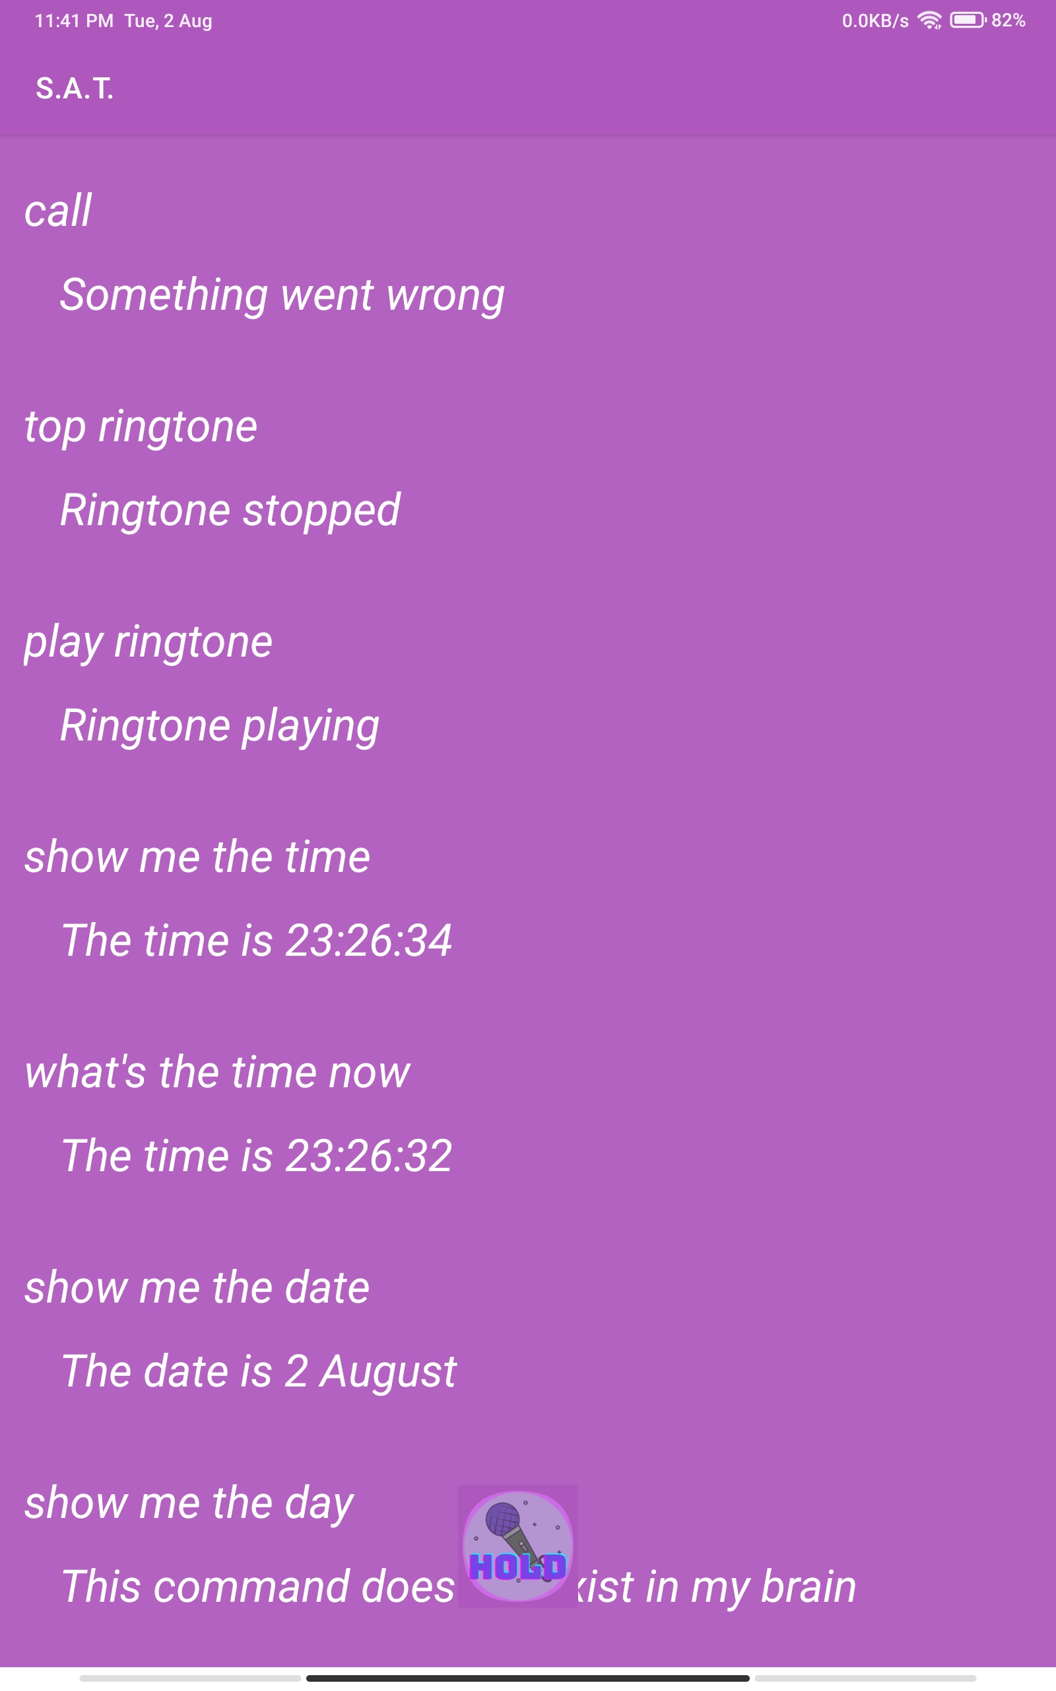
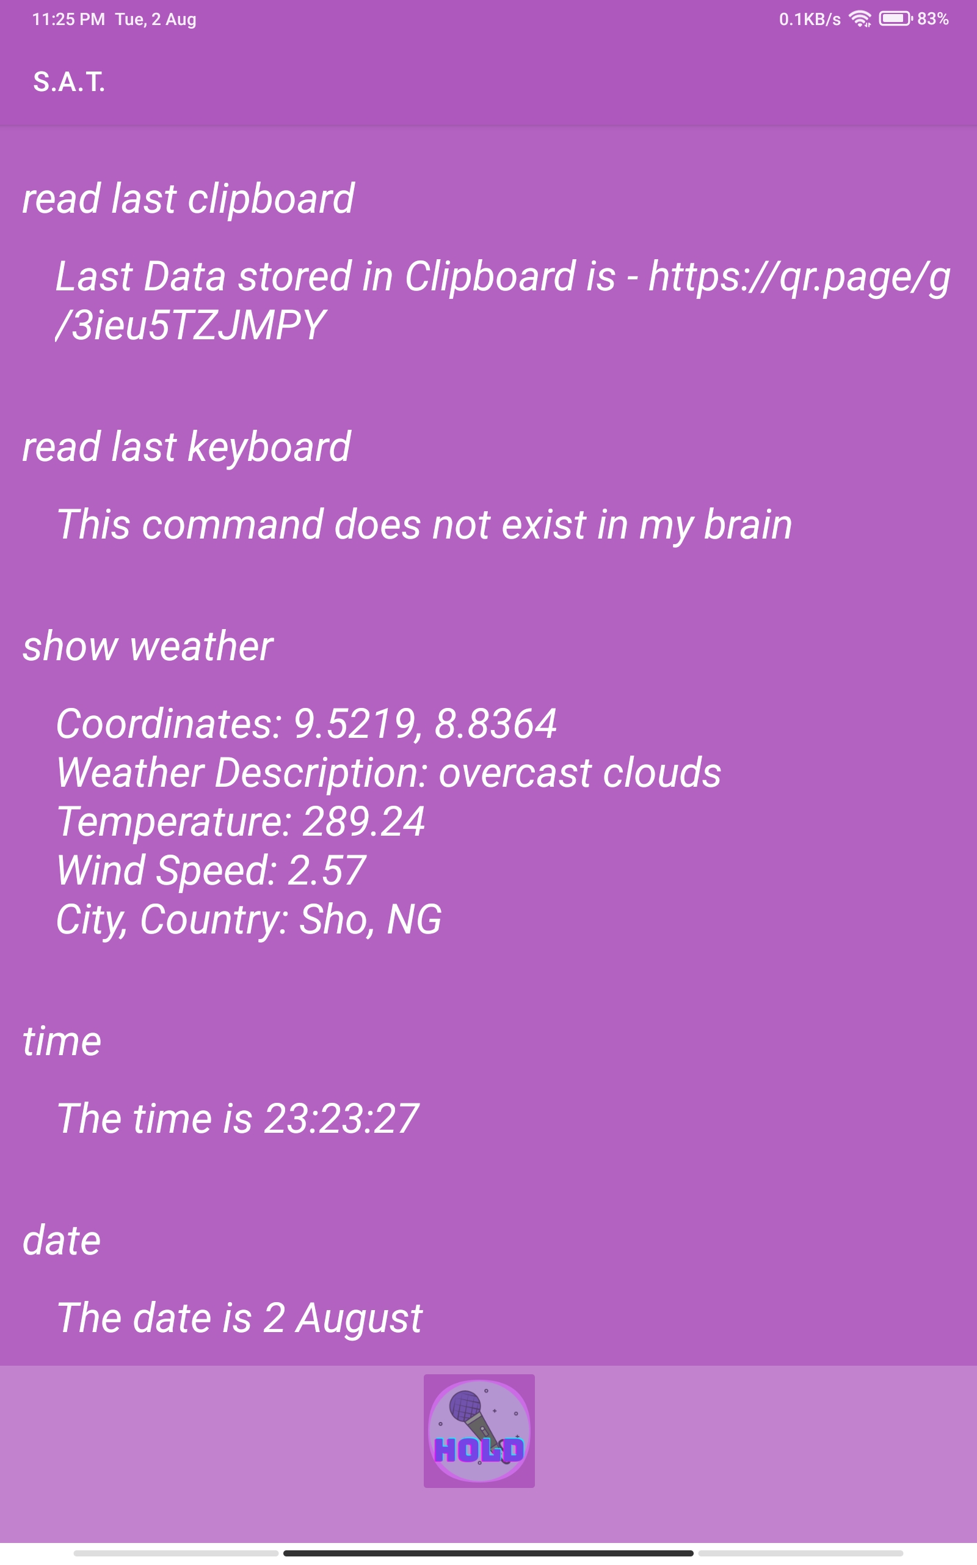
Play and Stop current ringtone
Last ClipBoard Data
weather
Date and Time

Slide 16

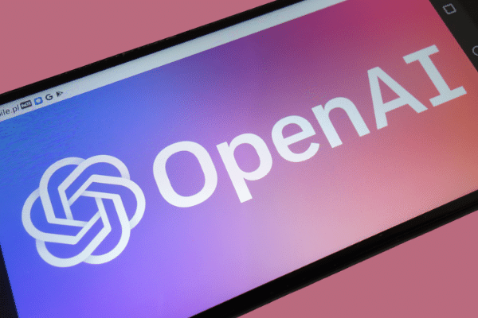
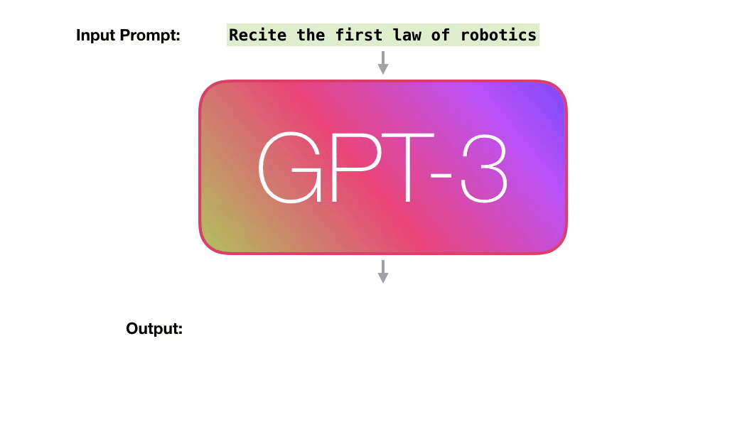
Future Scopes :
Integrating complex Neural Network Based Voice Models:
GPT-3, or the third generation Generative Pre-trained Transformer, is a neural network machine learning model trained using internet data to generate any type of text. Developed by OpenAI, it requires a small
l amount of input text to generate large volumes of relevant and sophisticated machine-generated text.
My project does not use traditional voice
Model which is based on pre defiend
Input outputs.
But in future there is a scope to
Implement GPT 3.

Slide 17
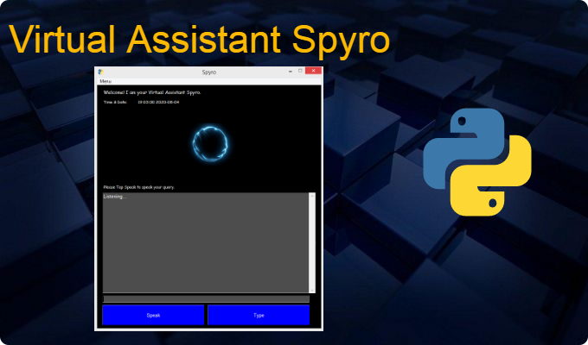
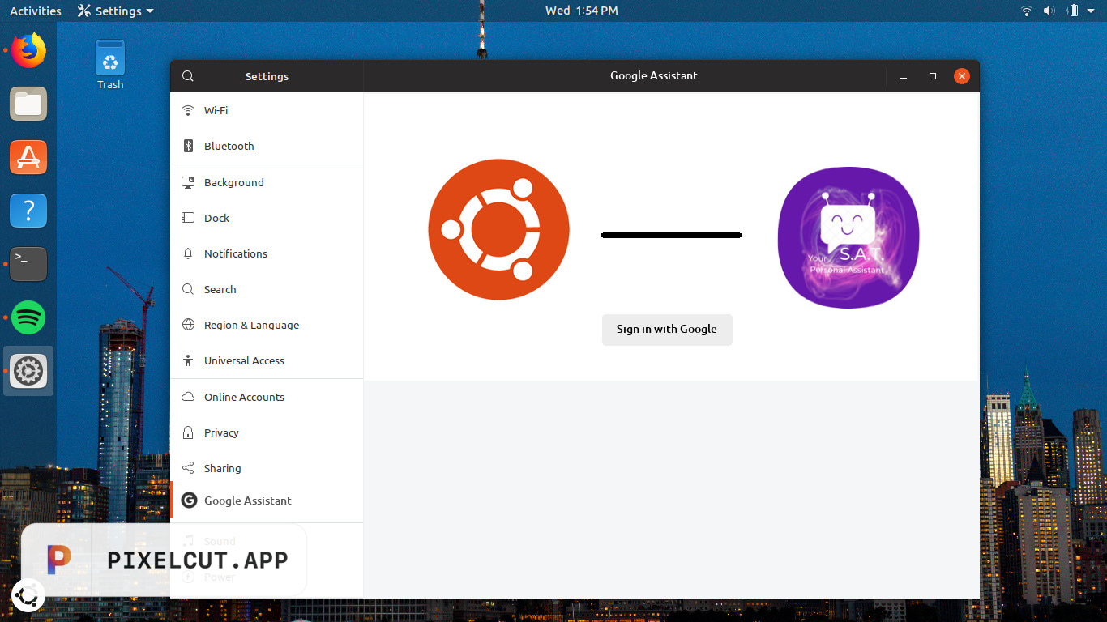

Future Scope 2 :
Integration with Linux Distributions:
Virtual assistants are generally do not built for Linux distributions and popular voice assistants like google, alexa, etc does not support linux.
But with the help of Ionic Framework we can easily integrated
My software into any link operating systems.

Slide 18

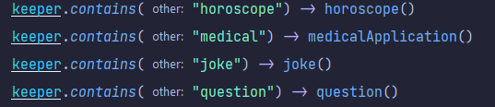
Constraints :
Some Features that cannot be implemented:
Some features like telling a joke or defining someone’s horoscope or asking a question etc. can’t get implemented due to lack of time and also of the old language neural network.

Slide 19
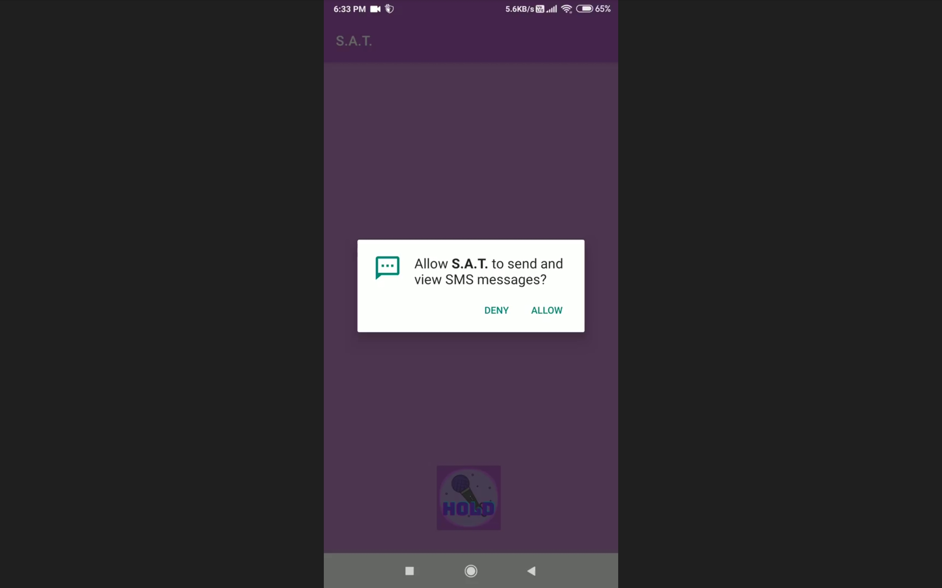
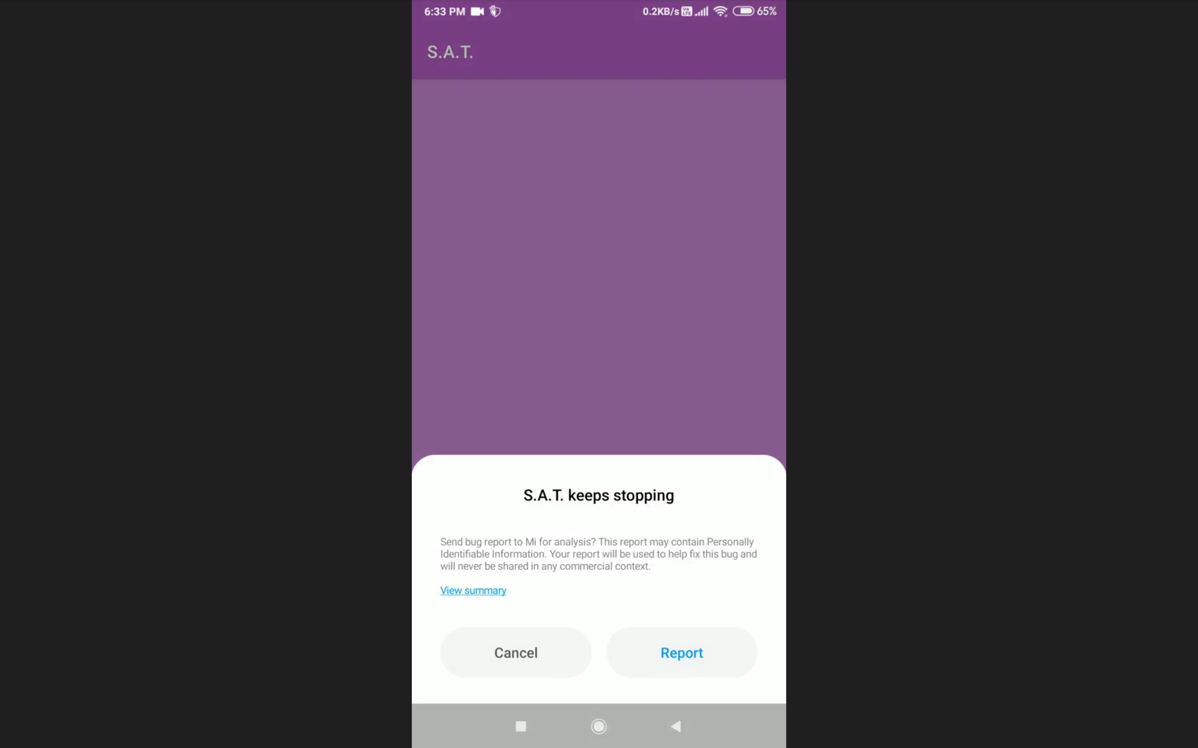
Constraint 2 :
App Crashing Issue:
Message sending options are not working properly. After
Giving the permission of sending the text message,
Instead of app opening, S.A.T
Just keep crashing. This is happening because some dependency version issue.

Slide 20
Constraint 3 :
Voice Recognition Problem:
Due to the very old traditional language model has been used, sometimes it cannot recognize the voice properly and
The 2nd point is you can clearly see that
We have to exactly say what’s written in the data dictionary, otherwise it wont work.

Slide 21

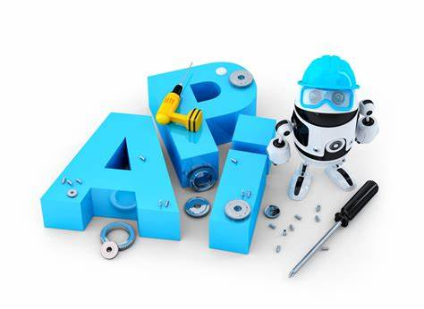



Bibliography :
Reference YouTube Channels and Websites:
Channel Names :
CodeWithHarry
Techno Learning
Free Code Camp
Websites :
https://developer.android.com/kotlin
https://www.geeksforgeeks.org/gradle-for-android-developers/
https://www.javatpoint.com/android-studio
Design Tools:

Slide 22


